Slide 1
Mobilize Customer Kick-off
Reduce time to achieve business outcomes and build the foundation for operational readiness

Slide 2
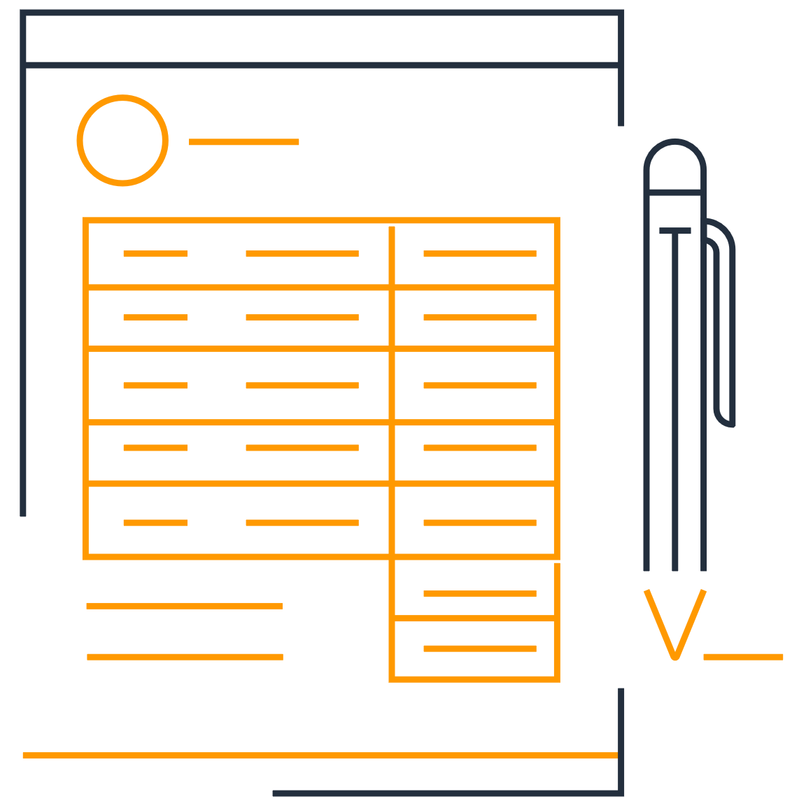
Agenda
1. Welcome
2. Mobilize Delivery Team
3. Mobilize Customer Journey
4. Customer Outcomes
5. AWS Delivery Methodology

Slide 3





Chime House Keeping Items
If you are not speaking please mute your line to decrease background noise!
We value inclusion and diversity. Everyone has a voice.
Let’s embrace this virtual meeting – turn on your video!
Bring a good cup of coffee!
Please be patient with any connectivity issues we may experience!

Slide 4



Mobilize Delivery Team
Mobilize
Insert Image
Insert Image
Insert Image
Insert Image
Insert Image
Insert Image
Insert Image
Insert Image
First Last
Engagement Manager Houston, TX
First Last
Landing Zone Lead
Tallahassee, FL
First Last
Landing Zone Shadow
Cincinatti, Ohio
First Last
Landing Zone SME
Boston, MA
First Last
Security Lead
Jersey City, NJ
First Last
Portfolio-Migration Lead
San Francisco, CA
First Last
Operations Lead
Herndon, VA
First Last
Operations Shadow
Tampa, FL
Mobilize Mentors
Rodney Grilli
Mobilize Mentor
Herndon, VA
Christine Screnci
Mobilize Mentor
Herndon, VA
Bo Lechangeur
Mobilize Mentor
Key West, FL
Notes:
Introduce Mobilize Team - each team member should have their camera on to introduce themselves and explain their role

Slide 5
AWS Roles Overview
Account Team
Account Manager
Customer Success Manager
Solutions Architect
Technical Account Manager
Overall Ownership for customer success on AWS
<Insert>
Customer Advocate ensuring success across all AWS implementations
<Insert>
Pre-Sales technical guidance to customer and Account Manager
<Insert>
Production Enterprise Support
<Insert>
Professional Services Team
Practice Manager
Engagement Manager
Consultants
Technical Experts
Landing Zone
ProServe Sales, delivery Success including staffing, escalations, and SOW scoping
<Insert>
Delivery oversight, engagement health, and stakeholder management
<Insert>
Implementation of Professional Services and technical expertise
<Insert Team Names>
Notes:
Explain billable and non-billable roles
Customer overview first

Slide 6



Customer journey
Mobilize
Assess
Mobilize
Migrate & Modernize
Portfolio
Migrate
Discovery & planning | Migration plan | Business case/ Mig. Evaluator | Migration & modernization experience
Culture & Change, CCoE | Landing zone | Operating model | Security & compliance
Migrate
Rapid discovery
TCO report
Migration Readiness Assessment
Operate & optimize
Modernize
Briefings & workshops
Immersion day
People
Platform
Create a case for change
Build readiness through experiences
Accelerate transformation at scale
Notes:
[MIGRATION JOURNEY]:
PRIMARY MESSAGE: MAP is built on a three-phase journey to systematically help you accomplish the migration journey. MAP starts with the Assess phase that includes a Migration Readiness Assessment (MRA) for your leaders and sponsors along with a Rapid Discovery to support creation of a TCO model to help you build business support for your migration project. The second phase is Mobilize, which includes Mobilize projects identified in the MRA to build your capabilities and get first-hand experience how easy it is to migrate to AWS. Mobilize includes four accelerators pictured here and the level of activity required in these work streams is determined by the readiness levels determined during the MRA. Mobilize activities include the actual migration of a recommended 3-5 applications, which is how your teams build migration capabilities alongside migration experts from AWS or partners. Mobilize typically runs from 2 to 4 months and involves ProServe and/or a partner that prepares you for large-scale migration and operation which is phase three. During Migration and Modernization, you will continue to migrate waves of applications, and operate and optimize your cloud environment and applications.
DETAILED MESSAGE:
We have developed MAP based on previous customer experiences to create an efficient and effective approach to migrations through three phases:
The Assess phase is the beginning of your journey, and sets the foundation for a well-planned and executed migration. A Migration Readiness Assessment (MRA) completed in the Assess phase helps you determine your organizations capabilities, readiness, and commitment to migrate to the cloud. During the MRA, we also look to quickly follow the assessment with a Rapid Discovery of your portfolio and create a Refined TCO report for the project. We provide discovery and business case tools free of charge during this phase to get the project launched.
After the Assess phase, you progress to the Mobilize phase, which builds capabilities to migrate and operate in the cloud. The focus is on developing a landing zone, operational readiness, cloud skills, a strong migration plan (including initial migrations), and a compelling business case for the migrations. [More Mobilize details if needed]
The Mobilize phase prepares you for the Migrate & Modernize phase, where you execute large scale migration and cloud operations. After completing the Mobilize phase, migrations can proceed rapidly and efficiently during the last phase, since it builds on established foundational capabilities. Each successive migration establishes a full-scale cloud operating model.
[More Mobilize details to be described as needed]
The Mobilize phase is typically 2 – 4 months (based on your organization’s readiness levels) and is executed with a selected partner or AWS ProServe resources.
The Mobilize engagement uses Accelerators to deliver the following outputs/outcomes for customers:
Collect inventory and application data to assess the portfolio and develop decision criteria to create initial migration wave plans.
Deploy and validate the landing zone, develop required operating and governance models, and migrate up to 5 applications to the customer production environment.
Gain hands-on experience operating in the cloud to build confidence, skills, and competency for the migration and transformation of the organization.
Define, implement, scale and automate (where applicable), the customer’s security risk and compliance controls on AWS.
Establish the future operating model for cloud and plan, guide and support an efficient progression of the operational model during the migration.
These Accelerators generate early alignment, speed-up requirements gathering, and expedite first migrations to compress the overall engagement timeframe.
The Mobilize Accelerator helps customers establish and exercise an agile program to accelerate cloud operational readiness and cloud migrations. This Accelerator supports the set-up of low-cost collaboration and planning mechanisms that implement and automate many activities within the AWS Cloud Adoption Framework. These mechanisms optimize end-user experience for distributed teams and are foundational to execute readiness and migration initiatives. The Mobilize Accelerator builds the foundation that all other workstreams leverage to structure and prioritize work, collaborate and document knowledge, and report progress.
The Portfolio Accelerator is a sprint-based, interactive workstream designed to establish decision criteria for application migration candidates and accelerate the development of a migration wave plan.
The Platform & Migration Accelerator deploys and validates the landing zone, develops required operating and governance models, and migrates up to 5 applications to customer production environment. The accelerator leverages Platform and Migration Parties to accelerate application migration, provide hands-on experience operating in the cloud, and build confidence across cross-functional teams. Activities within the Platform & Migration Accelerator are broken into Pre-Party, Party, and Post-Party stages and will conclude with post migration acceptance testing and validation of the landing zone. There is a defined, programmatic approach to successfully organize and plan the accelerator which is detailed in this document.
The People Accelerator advances an enterprise’s ability to create, sustain and govern the change that occurs to enable cloud adoption.
See the internal Mobilize wiki for more details: https://w.amazon.com/bin/view/AWS/Teams/Proserve/Migration/Mobilize/

Slide 7
Mobilize: Customer Outcomes
Foster alignment on business, IT goals, and scope Review app landscape (from pre-work) Finalize the decision criteria for prioritization and qualification of candidates, and disposition Create roadmap of the critical path items for the whole workstream Identify 3-5 pilot apps for a Platform Party (time permitting, discover details of the applications) Develop the initial Wave Plan for the migration Surface, Discuss and Address big rocks and sacred cows in the wave plan | A landing zone suitable for application types in scope Security controls in place for intended application and data types Defined (where needed) and ratified accountability between stakeholder teams Adapted operational procedures for critical domains Simulated production needs for day-2 production Generated real-world inputs to replace assumptions and inform business case | Migrated apps to AWS (3-5 applications) Developed/documented migration patterns for use by the organization to scale migrations Hands-on experience by collaborating with migration experts Adapted day-2 operations and security model in place and running for in-target applications Surface and address other requirements to support scale and speed for identified migration scenarios (application patterns) | Implement culture and change leadership framework to minimize business disruption related to culture, organization, and talent Draft interim CCoE structure and functions with high-level understanding of key metrics, interaction points, outcomes, and activities Scope the magnitude of change required by identifying all stakeholder groups affected by the Cloud and the high-level ways that they will be affected Enable leaders to drive culture changes required to achieve business outcomes and lead the organizational journey
Portfolio Accelerator
Platform Accelerator
Migration Accelerator
People Accelerator
Mobilize
Update to match customer’s outcomes
Mobilize Accelerator
Sets the foundation that all other workstreams leverage to structure and prioritize work, collaborate, document knowledge, and report progress
Video Library & IT Governance Decision Catalog
A Knowledge Base that contains completed activities, decisions, and runbooks to support ongoing operations
Sustainable governance mechanisms to manage cloud operations beyond Mobilize
Notes:
Portfolio - Mobilize Portfolio Party accelerates the discovery and analysis of the customers applications and infrastructure resulting in a prioritized migration wave plan
People - Mobilize People Party accelerates the selection of the initial operating model and identifies learning paths for each member of the customer’s core cloud team (CCOE or other acronym)
Platform - Mobilize Platform Party accelerates the design, build, and validation of the customers AWS operational capability and covers LandingZone, Security, and Operations readiness activities
Migration - Mobilize Migration Party accelerates the design, build, and validation of the migration factory leading to the first migration cutover into production

Slide 8
Roadmap & Timeline
ESTIMATED TIMELINE
Mobilize
Weekly Customer Executive Meeting
Sprint 0
Sprint 1
Sprint 2
Sprint 3
Sprint 4
Sprint 5
Sprint 6
Sprint 7
Sprint 8
Sprint 9-n
Launch Ready Planning (LRP)
Mobilize Accelerator
Procure Tools & Deploy Delivery Kits
Load Tailored Backlogs
Weekly Sprint Cadence (Stand-ups, Demo, Retro, Planning)
Sprint Ceremonies Begin
People Planning
Leadership Alignment & Stakeholder Assessment
People Party
Case for Change
Org Change Readiness
Key Messaging for Communications
People Accelerator
OCM RACI & Risk Mitigation Strategy
OCM Metrics
Change Strategy & Plan
Change Impacts
Platform Planning
Platform Buildout or Platform Validation Includes Landing Zone, Security, and Operations
Platform Party Promote 1st app to Dev
Platform Party Remediation
Security Jam & Operations Game Day
Platform Baselined
Platform Optimization Activities
Platform Accelerator
Migration Accelerator
Migration Planning
Migration Patterns Analysis
Migration Factory Deployment
Pilot Applications Design Baselined
Migration Factory Testing
Migration Preparation Work
Move Party 1st App in Prod
Migration Prep
Move Party n App in Prod
Migration Prep
Move Party n App in Prod
Validate Pilot Applications Discovery & Design
Portfolio Accelerator
Portfolio Planning
Discovery Party
(Application scope, tooling)
Pilot Application Discovery & Design
Analysis Party
(output analysis)
Pilot Application Discovery & Design (continued)
Wave Plan Draft
Continuous Data Enrichment and Validation
App/Infra 7R Disposition, Categorization and Prioritization
Wave Plan Baselined
Notes:
Mobilize provides customers flexibility and we work with customers to tailor the engagement based on the customer's desired business outcomes. The timeline below serves as a template or starting point that should be modified and tailored based on customer requirements.

Slide 9
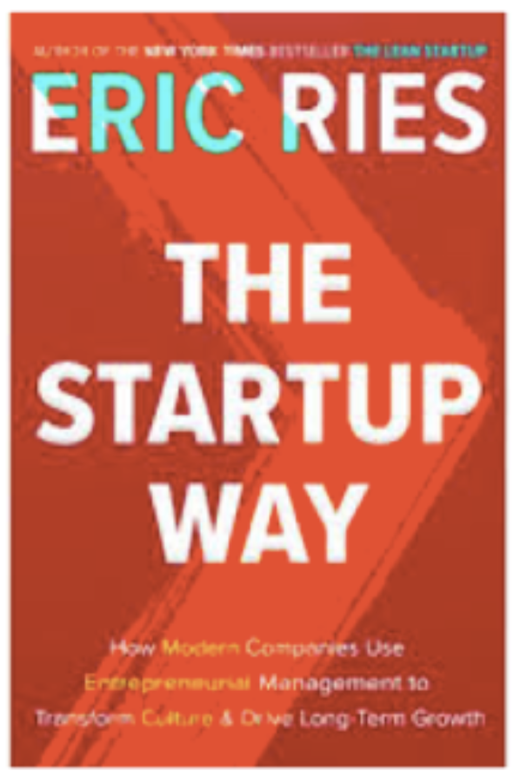

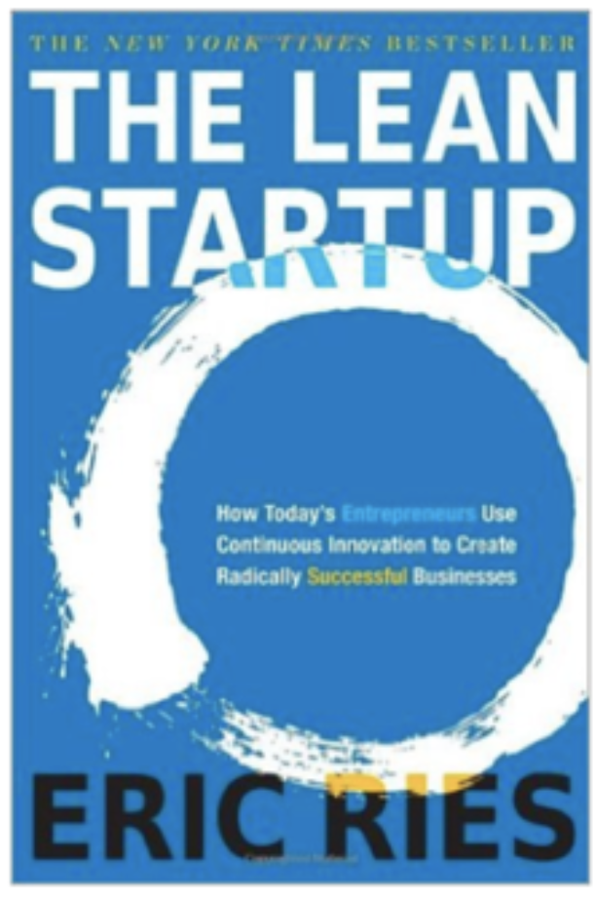
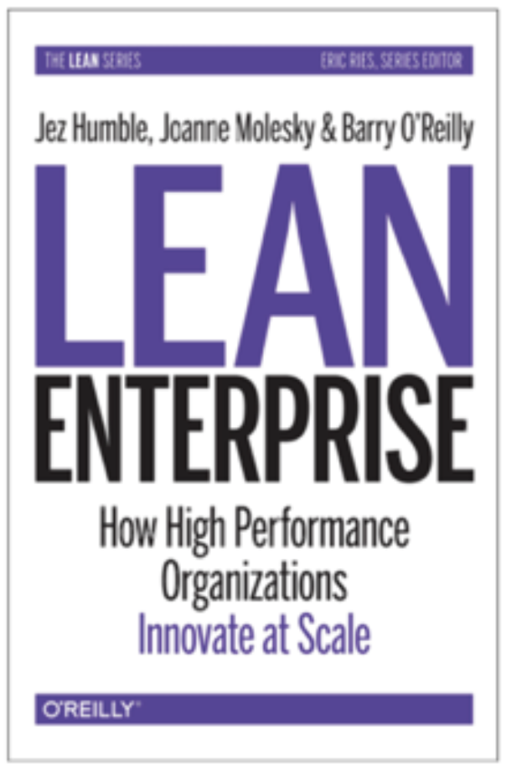


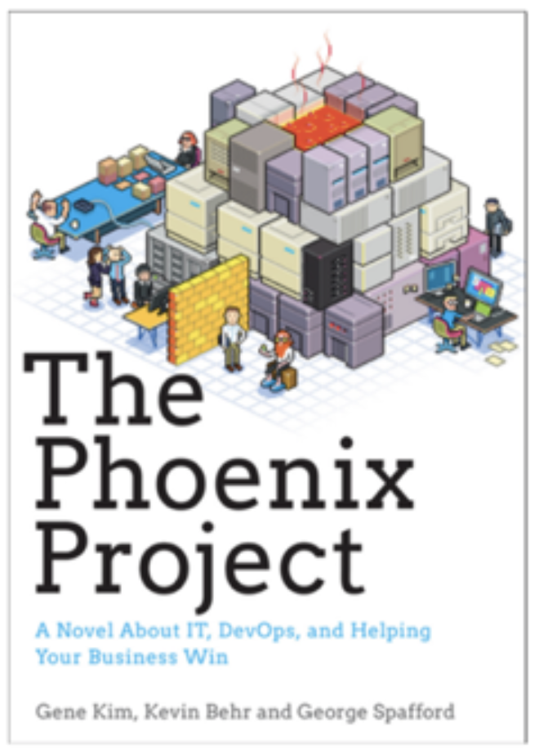
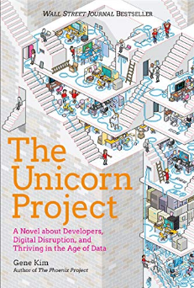

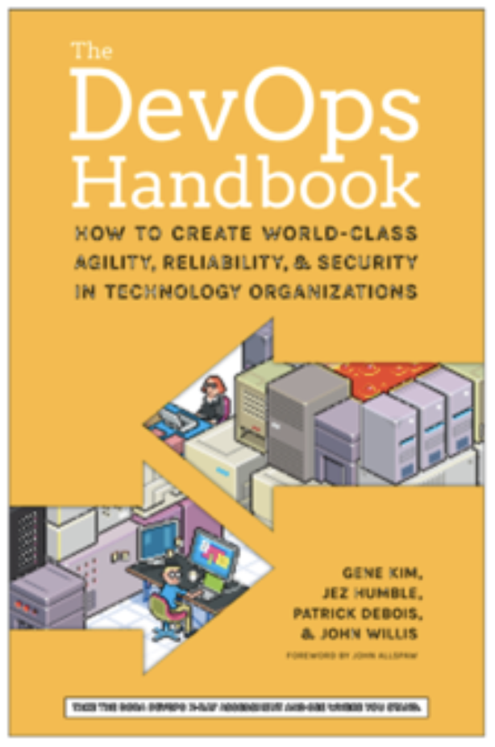
How do we organize for innovation?
Is it a one-way or a two-way door?
Two-Pizza teams are fast and agile, foster ownership and autonomy
Notes:
Mechanisms
Encoded behaviors that facilitate innovative thinking
Architecture
Structure that supports rapid growth and change
Culture
Customer obsession, hire builders, let them build, support them with a belief system
Organization
Small, empowered teams that own what they create

Slide 10
Customer Commitments Required
Executive Sponsorship Identify Executive Sponsorship (C-Level). Establish weekly cadence with Executive Sponsor to unblock issues, expedite processes, and make decisions.
Customer Team
Identify customer staff to be available full-time, 3-5 days per week, for the duration of the engagement. Assign single-threaded leaders to drive work stream teams using “two-in-the-box” approach with AWS consultants.
Agile Methodology & Tools Customer to put in place, or extend, engagement tools that support an agile methodology and provide communication and tracking to implement proper governance: Jira, Confluence with Draw.io plugin, Persistent chat, Remote collaboration that provides screen share and recording capabilities.
Mobilize
Notes:
PRIMARY MESSAGE: We know enterprise migrations can be challenging. It is a disruptive process for your business and IT organization specifically. You must deal with some complex challenges; including, deconstructing and understanding the on-premise technical environment, changing your operational processes, and helping your organization through cultural change – among other issues. In response, we developed best practice guidance based on our experience successfully migrating hundreds of enterprises. As a leadership team, you must demonstrate clear conviction to move to the cloud – not just with sponsors but with senior management leaders in all organizations across the business. You must set, measure, and assign responsibility for clear business goals for your entire organization.
We work with customers in advance of an engagement to discuss and establish success factors for the Mobilize phase. Ideally, this is a conversation that begins pre-sales prior to a Statement of Work (SOW) and the details are finalized prior to the engagement kick-off.
Agile Methodology & Delivery method is based on agile principles and uses one week sprints. The artifacts created during this engagement move through a governance process to Executive Sponsorship for approval and submission to the IT Governance Decision Catalog and Knowledge Base, ensuring customer acceptance of deliverables.

Slide 11
Mobilize: Readiness through experience
Mobilize
Establish and exercise an agile program to accelerate cloud operational readiness and cloud migrations.
At project close, the customer retains the Knowledge Base containing completed activities, decisions, and runbooks that support ongoing operations.
Set-up low-cost collaboration and governance mechanisms to manage cloud operations beyond Mobilize. (e.g. Agile Operations Workflow, IT Governance Decision Catalog, Video Library, Security Compliance Catalog, Application Migration Mechanisms)
Build the foundation that all other workstreams leverage to structure and prioritize work, collaborate and document knowledge, and report progress.
Establish stronger organizational change capability by engaging new ways of working (e.g. cross-functional collaboration, agile).
Notes:
Transformation
The Mobilize Phase helps customers establish and exercise an agile program to accelerate cloud operational readiness and cloud migrations. This engagement supports the set-up of low-cost collaboration and planning mechanisms that implement and automate many activities within the AWS Cloud Adoption Framework. These mechanisms optimize end-user experience for distributed teams and are foundational to execute readiness and migration initiatives. This engagement builds the foundation that all other workstreams leverage to structure and prioritize work, collaborate and document knowledge, and report progress.
The Mobilize Phase has the following objectives:
Ensure high visibility with Executive Sponsor.
Leverage agile methodologies, project control, business communication plan, and execute delivery of the migration plan.
Work with key stakeholders to assemble project teams, assign responsibilities, and develop schedules to ensure timely project completion, while minimizing risk to maximize customer success.

Slide 12
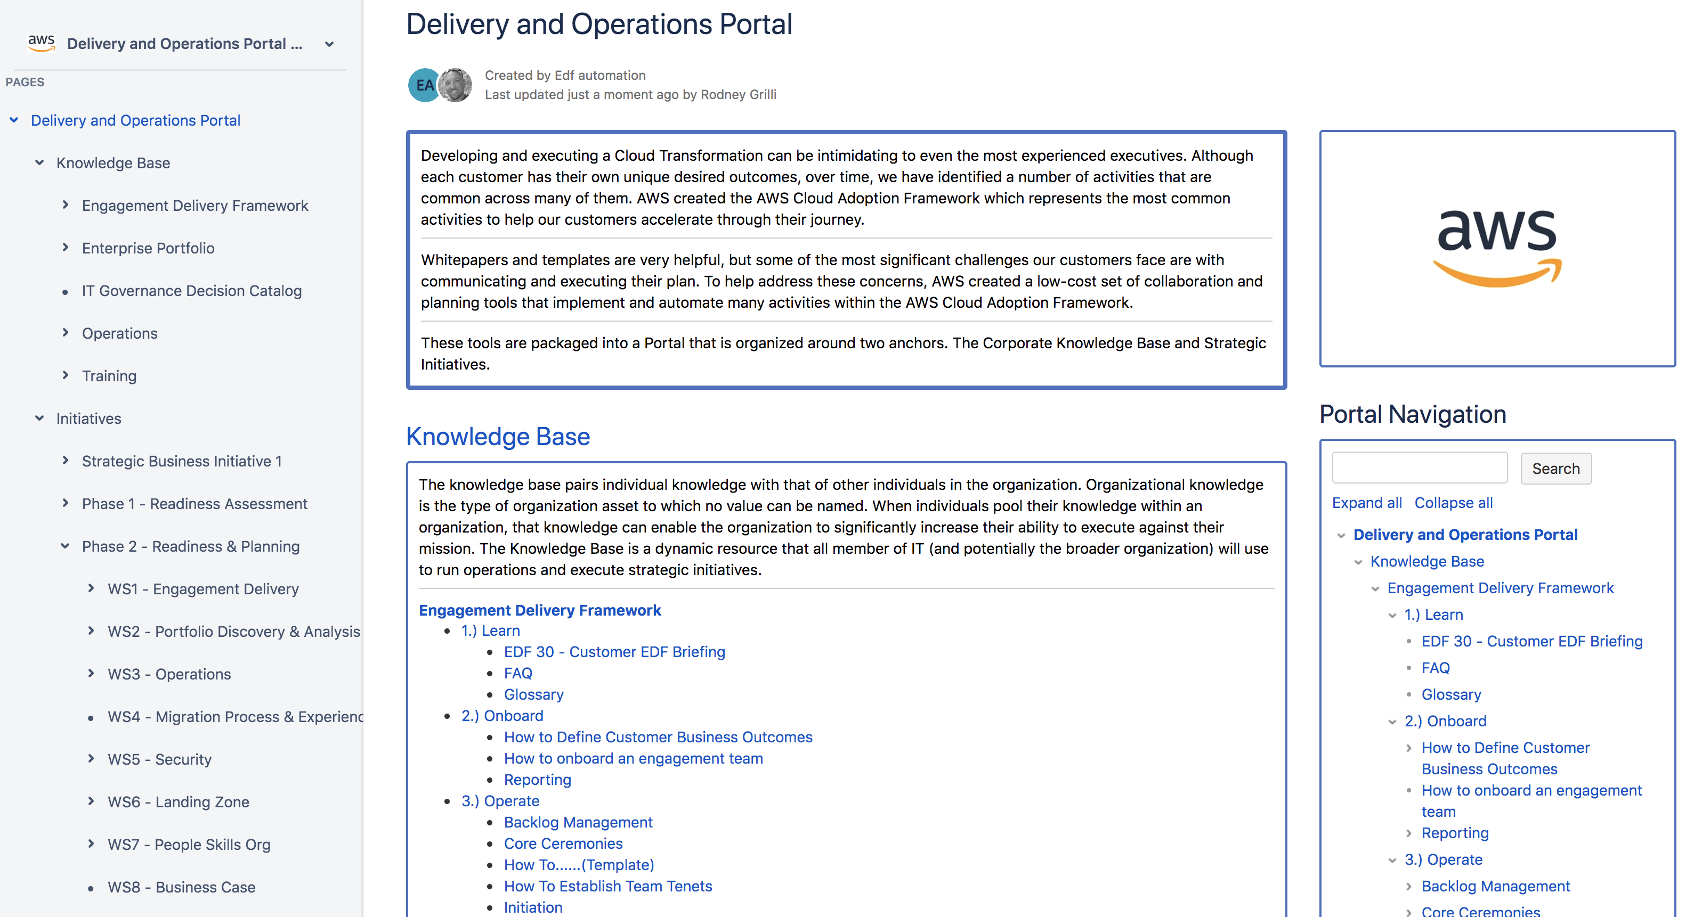
Delivery and Operations Portal
Mobilize Demo
The Knowledge Base is implemented as an online tool hosted in the customer’s environment. Delivery Kits are imported and artifacts are baselined throughout Mobilize.
At project close, the customer retains a Knowledge Base containing completed activities, decisions, and runbooks that support ongoing operations.
Notes:
The Mobilize offering is designed to optimize both remote delivery and ongoing operations for geographically distributed customer teams. The purpose of this Demo is to provide best practices for either in-person or remote delivery. Whitepapers and templates are very helpful, but some of the most significant challenges our customers face are with communicating and executing their readiness and migration initiatives. To help address these concerns, the Mobilize offering includes a low-cost set of collaboration and planning mechanisms that implement and automate many activities within the AWS Cloud Adoption Framework. These mechanisms optimize end user experience for large distributed teams.

Slide 13
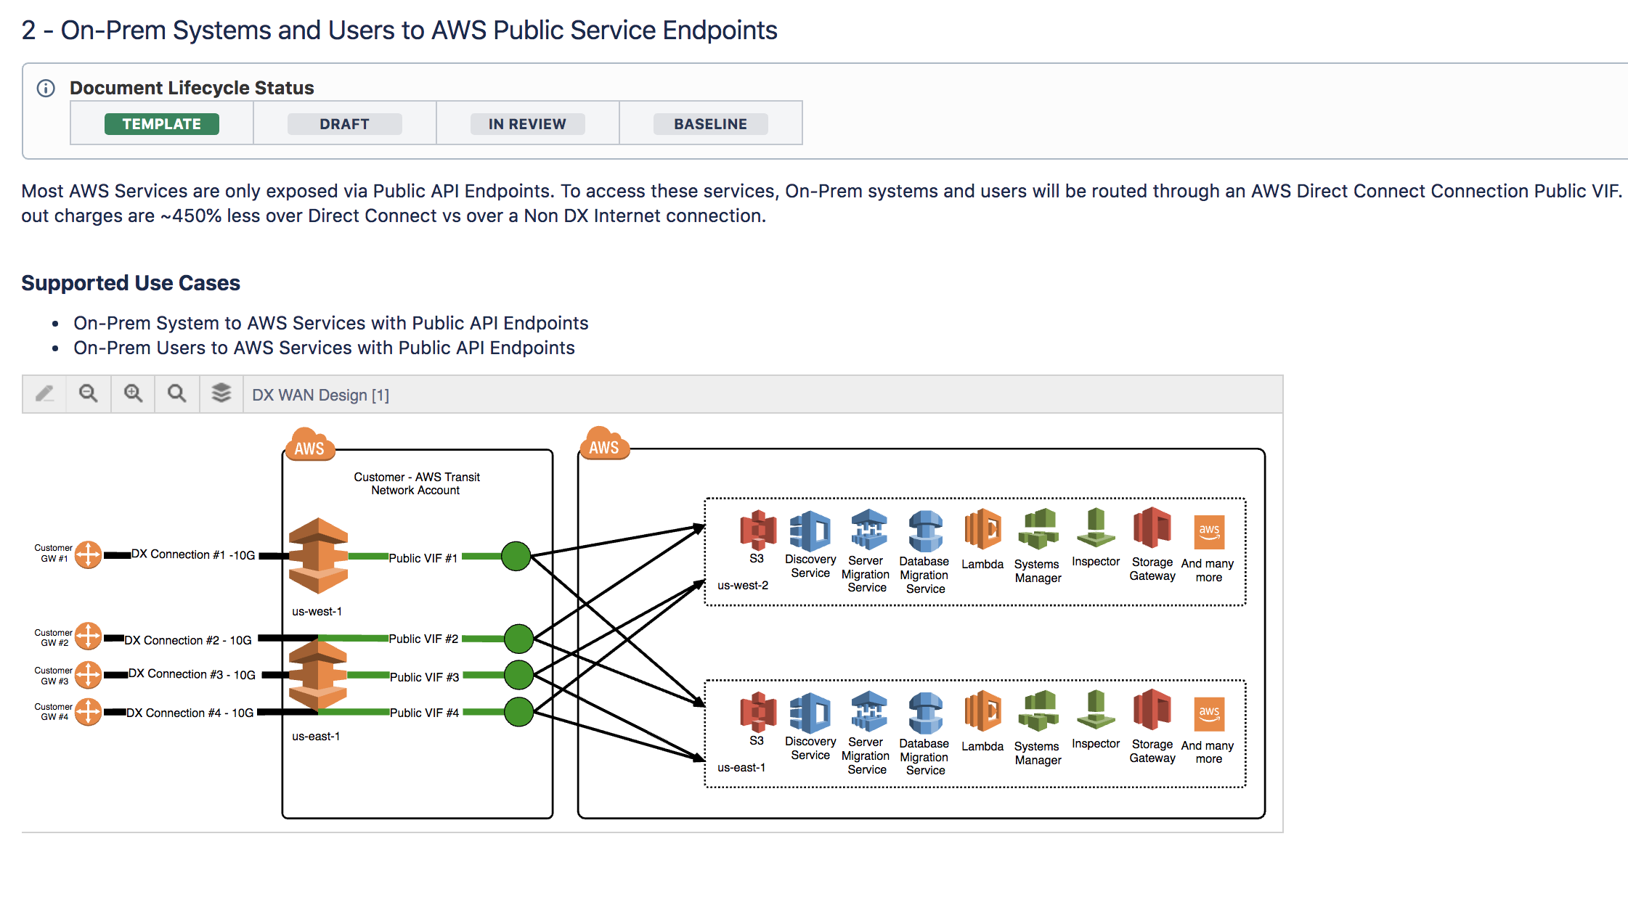
Technical Design Diagrams & Documentation
Mobilize Demo
Governance is built in to all documents and managed through weekly Sprint activities.
For example, once a document is “In Review” it’s shared at the weekly Sprint Demo. Then if the buyer accepts the artifact it’s moved into “Baseline”.
Design diagram templates are embedded within delivery kits using the Draw.io plug-in.
Notes:
Knowledge Management
The Knowledge Base is implemented as an online tool hosted in the customer’s environment and serves as the single repository for information regarding the customer’s cloud journey. The Knowledge Base pairs individual knowledge with that of other individuals in the organization. Organizational knowledge is the type of asset to which no value can be named. When individuals pool their knowledge within an organization, that knowledge can enable the organization to significantly increase their ability to execute against their mission.
Governance is built in to all documents within the Knowledge Base (see the Document Lifecycle Status at the top of each page). This is used in conjunction with the weekly Sprint activities. For example, once a document is “In Review” it’s shared at the weekly Sprint Demo. Then if the buyer accepts the artifact it’s moved into “Baseline”. Critical artifacts are sometimes provided to customer leadership through the IT Governance Decision Catalog for approval beyond baseline. Baselined documents are locked for editing in Confluence.

Slide 14
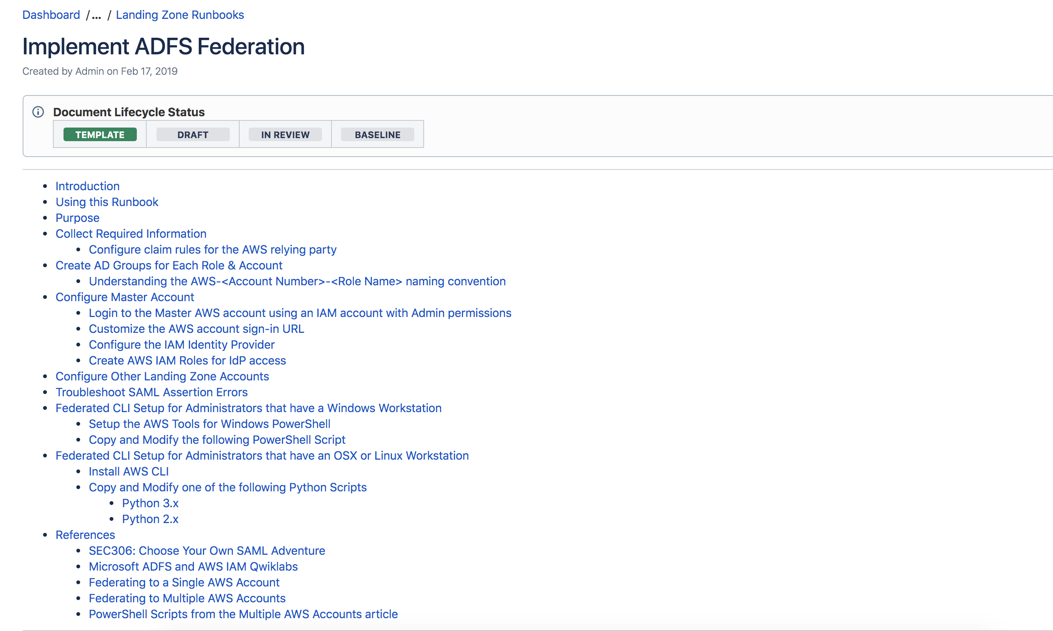
Operations Runbooks with Lifecycle Governance
Mobilize Demo
All technical and business artifacts developed and can be used to run operations, execute strategic initiatives, and serve as reference and training guidance for existing and new team members.
Notes:
The Knowledge Base is a dynamic resource that all members of IT (and potentially the broader organization) will use to run operations and execute strategic initiatives. The Knowledge Base serves as the single place to collaborate and bring a work product through a governance process to validate customer acceptance. The completed Knowledge Base is intended to be a self-service online library including any and all relevant operational Artifacts and Runbooks. At the completion of the Mobilize engagement, the Knowledge Base will encapsulate all technical and business artifacts developed and can be used as reference and training guidance for existing and new team members. Currently, the delivery kits that are used to seed the Knowledge Base are in Confluence format, and additional formats are targeted for future releases.

Slide 15
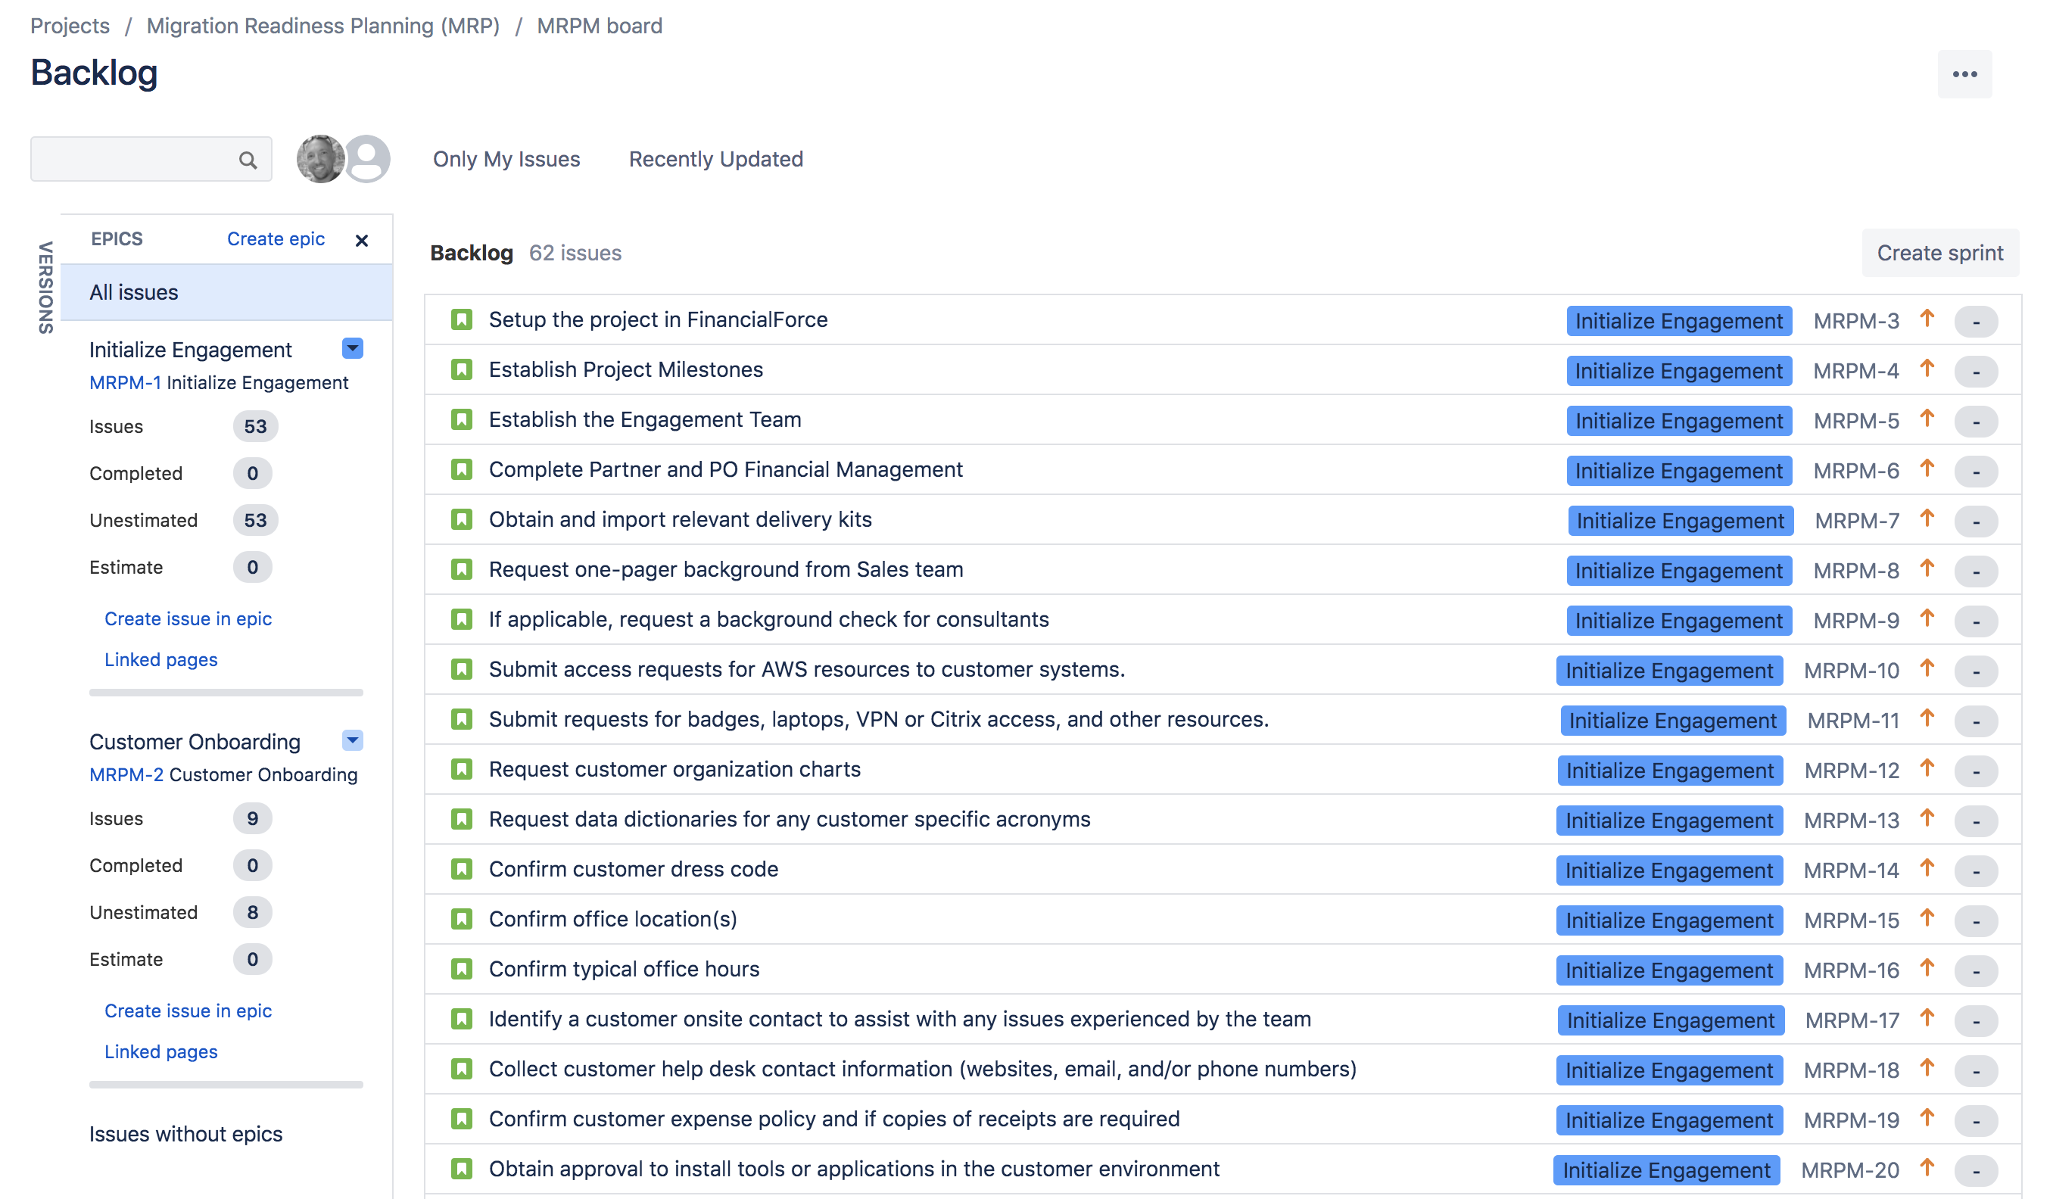
Readiness & Planning Backlogs
Mobilize Demo
No project plans are used. Instead, a template backlog is tailored to customer requirements. These backlogs are managed in an online tool to provide tracking against the Sprint Goals and offer full visibility to project teams and Executive Sponsorship even when geographically dispersed.
Notes:
Workflow & Activity Management
Delivery is based on agile principles and uses one week sprints to work through the backlog. No project plans are used. Instead, each workstream has a template backlog from which Consultants should tailor the activities specific for the customer. These backlogs are managed in an online tool to provide tracking against the Sprint Goals and offer full visibility to project teams and Executive Sponsorship even when geographically dispersed. Currently, the delivery kits that are used to seed the Backlog are in Jira format, and additional formats are targeted for future releases.

Slide 16
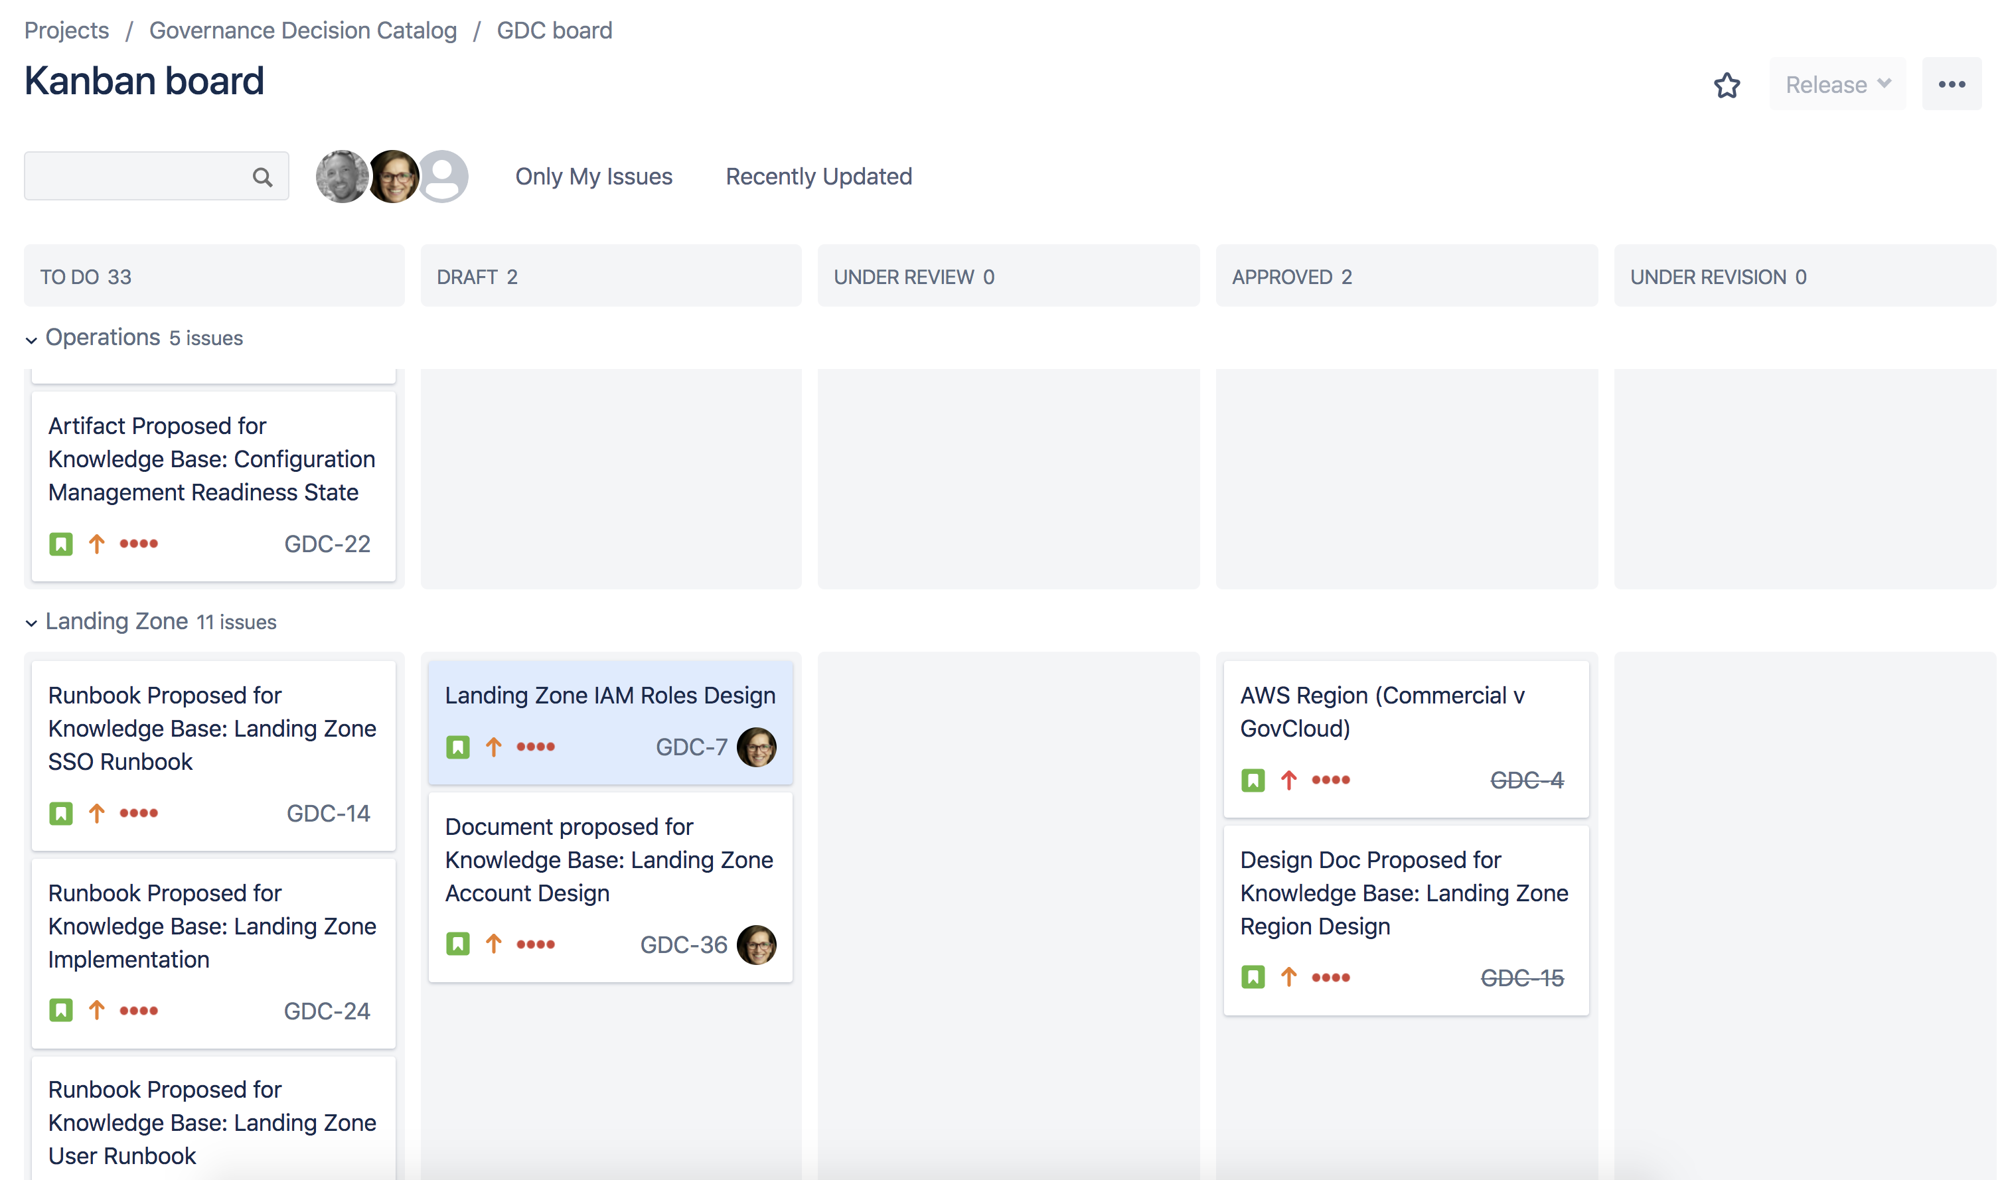
IT Governance Decision Catalog
Mobilize Demo
Hosted in the customer’s environment to serve as a centralized place to track the customer’s decisions throughout their cloud journey.
This mechanism helps facilitate the decision workflow and serves as a historical record. All stakeholders involved in the project have access to this catalog to be able to view final decisions and propose recommendations and/or request decisions.
The recommended workflow helps customers manage two-way door decisions and overcome blockers by requiring data and documentation to support decisions.
Notes:
IT Governance Decision Catalog
An IT Governance Decision Catalog is an online tool hosted in the customer’s environment to serve as a centralized place to track the customer’s decisions throughout their cloud journey. This mechanism helps facilitate the decision workflow and serves as a historical record. All stakeholders involved in the project have access to this catalog to be able to view final decisions and propose recommendations and/or request decisions. The recommended workflow helps customers manage two-way door decisions and overcome blockers by requiring data and documentation to support decisions.

Slide 17
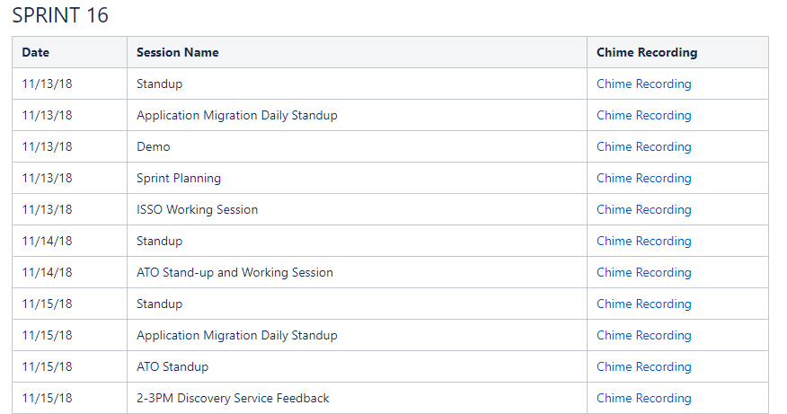
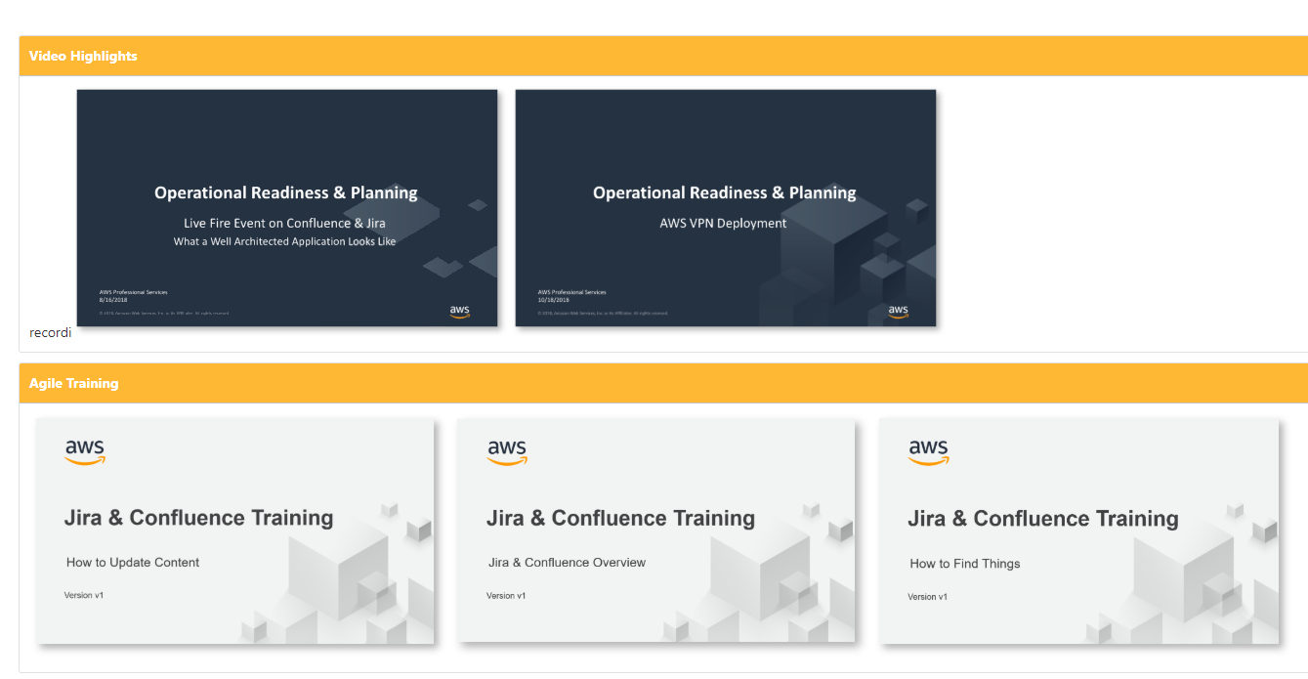
Video Library
Mobilize Demo
All sprint ceremonies and work stream sessions are recorded. Recordings capture screen sharing and audio, ensuring visibility and knowledge transfer for either existing or new team members. This mechanism removes engagement blockers because meetings can still be held, even without all stakeholders. Absent stakeholders can later watch the meeting and provide inputs asynchronously. Organizations are able to capture the evolution and details of an engagement such that future, new team members are able to view recordings to support training and awareness.
Notes:
Video Library
All sprint ceremonies and work stream sessions are recorded. Recordings capture screen sharing and audio, ensuring visibility and knowledge transfer for either existing or new team members. This mechanism removes engagement blockers because meetings can still be held, even without all stakeholders. Absent stakeholders can later watch the meeting and provide inputs asynchronously. Organizations are able to capture the evolution and details of an engagement such that future, new team members are able to view recordings to support training and awareness. The recording library supports a geographically dispersed workforce, as well as a remote workforce, that may need to watch meeting recordings after the fact due to competing priorities or timezone challenges. Given the current global situation with COVID-19 many workers are balancing work and caring for others, and the recording library supports improving the lives of these professionals.

Slide 18
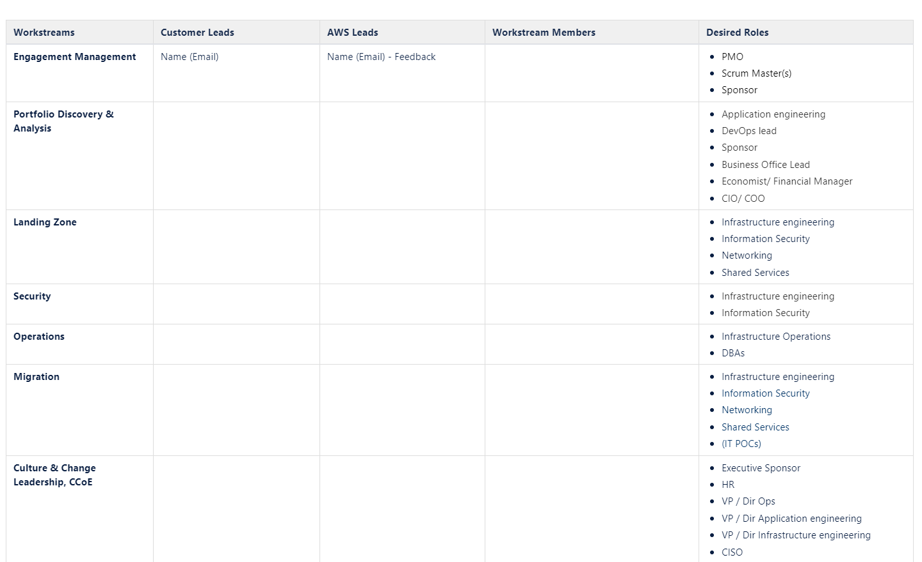
Workstream Leads and Members
Mobilize Demo
We work with the customer Executive Sponsor to identify the core team of customer staff that will be single-threaded leaders for each workstream and will be available full-time, 3-5 days per week, throughout the entire engagement.
Notes:
Pre-Planning with Customer Executive Sponsor
We work with the customer Executive Sponsor (typically at the CIO and Deputy CIO level) to identify the core team of customer staff that will be single-threaded leaders for each workstream and will be available full-time at least 3-5 days per week throughout the entire engagement. For onsite delivery, AWS Consultants are typically onsite Tues-Thurs, but in a remote delivery this timeline and the specific days are more flexible since no travel time is needed.

Slide 19
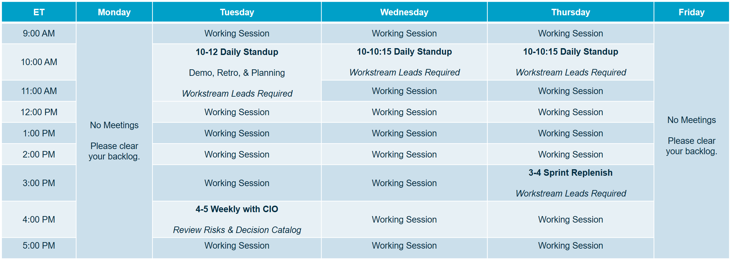
Agile & Weekly Sprints
Mobilize Demo
Mobilize occurs in one week sprints, where the sprint cycle starts/ends mid-week. Online tools are used for all sprint ceremonies which are executed via remote collaboration tools that allow for participant video, screen sharing, and session recording.
Notes:
Sprint Cadence
One week sprints are recommended, where the sprint cycle starts/ends mid-week with supporting sprint ceremonies (demo, retrospective, sprint planning). A daily stand-up is also held each day to ensure progress, communication, and to clear any blockers. Each week, a Customer Executive Sponsor meeting is held to disposition decisions in the IT Governance Decision Catalog, review the Risk Register and help clear any blockers. Online tools are used for all sprint ceremonies which are executed via remote collaboration tools that allow for participant video, screen sharing, and session recording. With a remote workforce, Governance through this cadence and online systems becomes even more critical. Through these mechanisms the Mobilize Product enables Governance that is inherently built-in to everyday work activities.

Slide 20
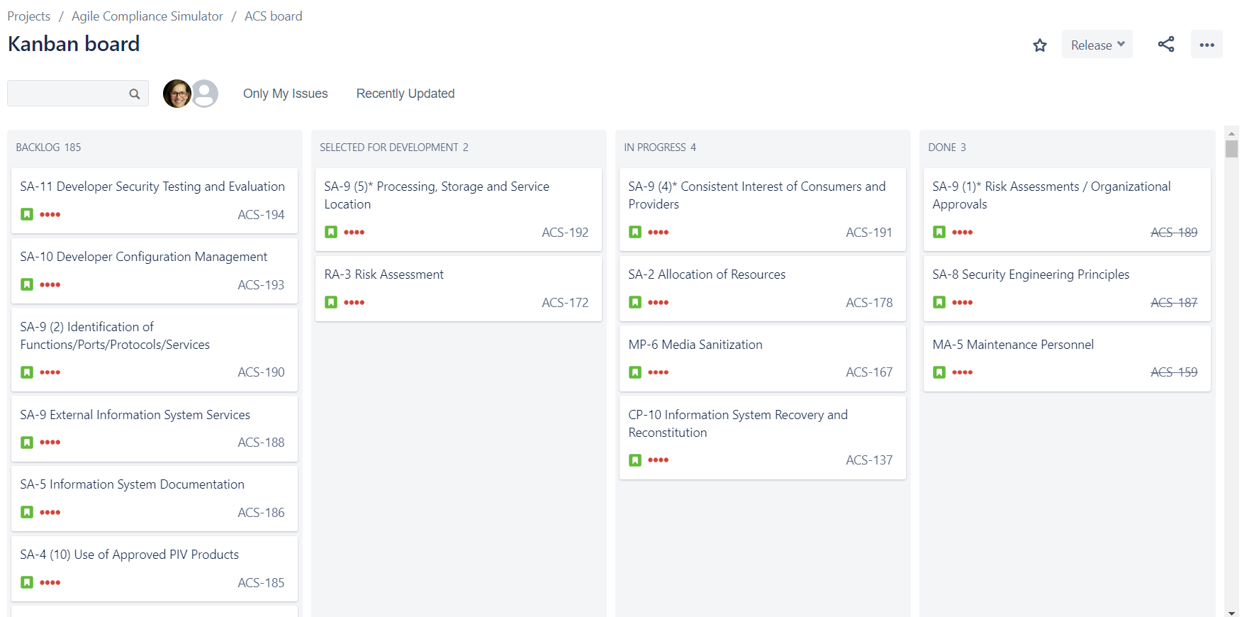
Agile Compliance Board
Mobilize Demo
Small, agile teams focused on security compliance. Security controls and justifications are tracked as tickets in weekly sprint cycles.

Slide 21
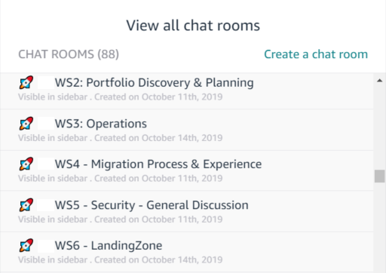
Persistent Chat & No Email
Mobilize Demo
Ground Rules and Team Norms are established with the Customer Executive Sponsor.
No Email Best Practice
All communications are conducted via persistent chat rooms/channels
All documents are managed within the Knowledge Base
All actions/activities are managed within the backlog tooling
All decisions are managed within the IT Governance Decision Catalog
Notes:
Persistent Chat
Persistent chat rooms for each workstream where team members can collaborate real-time and this serves as a historical record for others to get caught up. This works well for consultants that are running workstreams because they have more open lines of communication with the customer team. These rooms help keep stakeholders focused on completing their activities and allows for updates throughout the day to unblock others.
No Email Rule
All communications are conducted via persistent chat rooms/channels
All documents are managed within the knowledge base
All actions/activities are managed within the backlog tooling
All decisions are managed within the IT Governance Decision Catalog

Slide 22
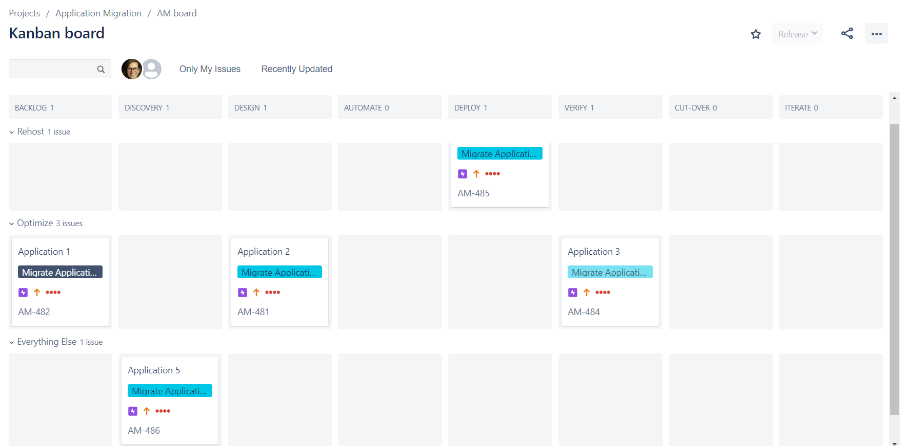
Application Migration Board
Mobilize Demo
Mobilize pilots will establish mechanisms to manage, track, and report migrations. These methods are sustainable beyond the Mobilize engagement.

Slide 23
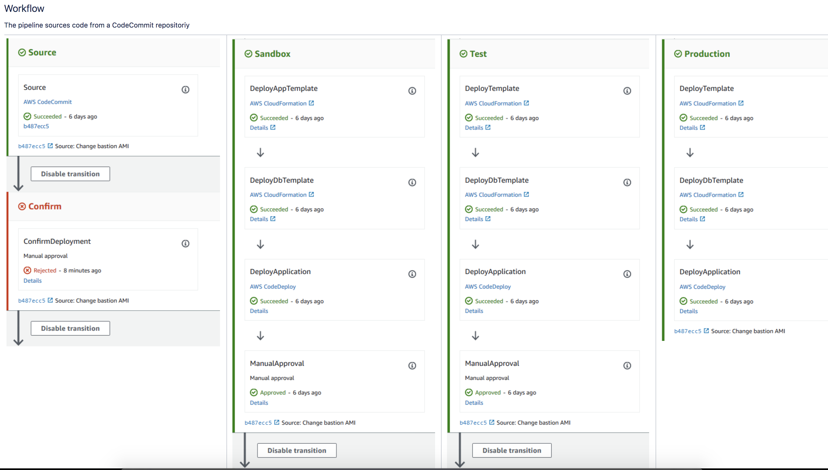
Fully Automated CI/CD Product Pipelines
Mobilize Demo

Slide 24
Next Steps
Pre-Planning and Sprint 0
Sprint 1
Deploy Delivery Kits in customer’s Confluence and Create projects in customer’s Jira
Establish Decision Catalog
Workstream Leads and Members Identified and dedicated to this project for 3-5 days/week full-time for the duration of the project
AWS Team on-boarded and can access customer’s Jira/Confluence
Launch Ready Planning (LRP)
Agile Roadmapping based on LRP
Load Tailored Backlogs into Jira
Sprint Ceremonies Begin
Weekly Executive Reviews Begin

Slide 25
Thank you!

Slide 26
Appendix

Slide 27


Migration projects can be challenging
Enterprise migrations are complex:
Deconstruct the on-premises technical environment
Performance and relationship of migrating applications
Understand the current operational processes
Policy issues and business rules
Security policies
Embedded tribal knowledge
People-related change impacts to leadership, culture, organization, and roles
Regulations
Best Practices
Demonstrated leadership
Set clear business goals
Develop cloud skills / address gaps
The highest risk has been in a stalled project or a false start
….. these can set a cloud program back by months, even years
Notes:
[MIGRATION PROJECTS CAN BE CHALLENGING]:
PRIMARY MESSAGE: We know enterprise migrations can be challenging. It is a disruptive process for your business and IT organization specifically. You must deal with some complex challenges; including, deconstructing and understanding the on-premise technical environment, changing your operational processes, and helping your organization through cultural change – among other issues. In response, we developed best practice guidance based on our experience successfully migrating hundreds of enterprises. As a leadership team, you must demonstrate clear conviction to move to the cloud – not just with sponsors but with senior management leaders in all organizations across the business. You must set, measure, and assign responsibility for clear business goals for your entire organization. Finally, you must develop cloud skills in your organization, likely starting with developing a cloud COE and addressing gaps in skills with strategic partners.
Managing these challenges with a proven framework is key to accelerating cloud benefits.

Slide 28
Accelerate Cloud Benefits
Mobilize
Migration
&
Modernization
Assess
Next 1-4 Weeks
Build knowledge and skills on key migration topics prior to committing to the Mobilize phase
Executive Alignment
Address identified gaps in areas of focus
Landing Zone
CCoE
Executive Sponsorship
AWS workshops, Immersion days, EBA parties
Security Briefing
CAF Envisioning & Alignment Workshop
Migration Immersion Day
Migration Party
Enterprise Transformation EBC
Next 2-4 Months
Outputs of the Migration Readiness Assessment (MRA) are used to help customers identify gaps to build an operational foundation and, if desired, prepare for a successful migration.
Fast-track deployment and operations of your AWS environment.
129 customizable documentation templates / knowledge base
Transparency through agile project delivery and weekly demos
Delivery kits aligned with AWS Well-Architected
Next 4 – N Months
Leverage the durable knowledge base containing completed activities, decisions, and runbooks to support ongoing operations, migrations, and modernization.
Batch migration using migration factory concept
Continuous service improvement by gap analysis and remedies
Establish automated CI/CD pipeline
Implement automated service catalog
Notes:
[MAXIMIZE YOUR MOBILIZE INVESTMENT]:
PRIMARY MESSAGE: The AWS methodology helps prevent false starts and avoid stalled projects.
The Mobilize offering uses outputs of the Migration Readiness Assessment (MRA) to help customers build foundational capabilities across the CAF and build experience in migration. Mobilize is an out-of-the-box solution containing customer modifiable templates, operations run books, workshops, and agile project delivery tools to help a customer accelerate their ability to deploy and operationalize their AWS environment. Modular delivery kits provide execution consistency and enable a broader set of consultants to successfully deliver Mobilize engagements. At project close, the customer retains a Knowledge Base containing completed activities, decisions, and runbooks that support ongoing operations.
In order to maximize the investment made during the Mobilize phase, it’s critical that the customer move directly into migration/modernization/manage. The Mobilize phase focuses on building understanding and skills, and it’s best for customer teams to put this new knowledge to use immediately to ensure skill retention and maintain the momentum of Mobilize.

Slide 29
Critical Components for Success - Moving to AWS
1
Senior leadership team conviction and alignment
Set clear direction and expectations with the organization to get everyone on the same page and working towards the same goal. Enabling cloud culture and change leadership capability is a critical first step to minimizing business disruption and accelerating mindset and behavior shift.
2
Set top-down aggressive goals
Force the organization to move faster than it would have organically to enable adoption to the new ways of working.
3
Train your builders
It’s really important that organizations are trained on the cloud and comfortable with the concepts as part of the whole process – we train hundreds-of-thousands of people a year for that purpose.
4
Don’t let paralysis stop you before you start
Organizations can get paralyzed if they can't figure out how to move every last workload. There is no need to boil the ocean – do a portfolio analysis to assess each application and build a plan for what to move short term, medium term, and last.

Slide 30
Rapid Migration Offer accelerates your transformation
CUSTOMER READY
AVERAGE CUSTOMER ENVIRONMENT, BY MIGRATION PATTERN (based on AWS experience)
REHOST Lift-and-shift to quickly capture business benefits; transform once migrated for additional value
RELOCATE Move VMWare-based apps to VMWare Cloud on AWS (VMC)
REPLATFORM Small optimizations (e.g. to reduce OS/DB licensing costs)
REFACTOR Reimagine app architecture & development
REPURCHASE
Move to SaaS
~40%
~5-10%
~25%
~5-10%
~5%
~5-10%
~5-10%
100%
RETAIN Not prioritized for migration
RETIRE No longer needed
FIXED-PRICE OFFER
CUSTOM OFFER
Full spectrum of patterns is important for transformation – but up to ~50% of typical environment can be rapidly migrated at a predictable price, freeing time & budget to focus on modernization
Notes:
Context: Time to value is critical. The industry standard is a time-and-material based project. This introduces risk in staying on time and under budget, both of which can affect a customer’s time-to-value. The Rapid Migration Offer drives three major changes: 1/ Improved predictability to pay a fixed price per server migrated instead of paying for a time-and-materials engagement, 2/ Improved efficiency by using the CE Migration Factory approach to minimize required decision making 3/ Drive faster acceleration to transformation by migrating low-hanging fruit to get immediate benefits while allowing customers to focus on modernization workloads.
Primary Message: At AWS, we have done many migrations and transformation. While each one is different, we have seen that, on average, customer environments fall into an R Pattern that consists of ~30-40% “rehost”, ~5-10% “rehost+” and ~5-10% “relocate” workloads. We see that the modernization and transformation R patterns of replatform, refactor and repurchase generally account for 30-40% of a customer’s estate. Our goal with the Rapid Migration Offer is to provide a quick and effective way for customers to migrate “lift and shift” workloads at a fixed cost, thereby minimizing price and time risk for this portion of a customer’s portfolio. We want customer’s to focus their time and effort on the modernization workloads, where key customer differentiated decision making drives value.

Slide 31
Operating your cloud
Self-Managed
Full control simplified with AWS tools
AWS Service Catalog
AWS Systems Manager
AWS Management Tools & Services
Modeling and Provisioning; Automation and Operations; Monitoring and Logging
3rd Party Tools
Change
Management
Access
Management
Security
Management
AWS Managed Services (AMS)
We operate your cloud with AWS best practices and compliance standards so you can focus on your business priorities
Addresses Security & Compliance
Managed AWS Landing Zone
Self-service automation
7x24 Worldwide AWS Operations Support Engineers
“Month-to-Month” terms: you can take back control any time
Incident
Management
Patch
Management
ITSM Integration
Provisioning
Management
Continuity
Management
Reporting
Partner Managed
Leverage AWS certified Managed Service Partners to help operate your cloud
100+ Managed Service Partners (MSP)
Certification Program
Third-Party Audit
Full Lifecycle Services
https://aws.amazon.com/partners/msp/
Notes:
[OPERATIONS]:
PRIMARY MESSAGE: Post-migration operations planning is important because once you migrate the very first application, you have to operate it in the cloud. During the Mobilize phase, you learn new requirements of cloud operations and adapt your existing operational model to support the cloud. You also have the opportunity to change how you approach operations with your migration to the cloud, as there are multiple options. As always, AWS and partners provide tools for cloud savvy organizations to self-operate using AWS Service Catalog and AWS Systems Manager. You also have the option to fully outsource operations with one of 100+ AWS Managed Service Providers. We want to make sure you are aware of another valuable option that is AWS-operated, which is AWS Managed Services; it operates your infrastructure from the patched OS-level, down – on a month-to month basis. AMS is a great option for offloading non-differentiated IT tasks as well as supporting your team during initial migrations. You can also use combination of these options to best fit your needs.
DETAILED MESSAGE:
We want to emphasize the importance of post-migrations operations. Once you have migrated a single application to production, you are now committed to cloud operations. It is important consider your cloud operations end-state and operations options during your migration planning.
[POST-MIGRATION OPERATIONS PRIORITIES]: Through the operations work stream of the Mobilize project, you will be considering key operational activities in your existing operations model adapting it to support a cloud operation model. Typically, you prioritize security, operational excellence, reliability, performance efficiency, and cost optimizations of your cloud operating model.
[OPERATIONS OPTIONS]: You have multiple options for operating in the cloud, ranging from Self-Operated, to AWS operated to outsourcing to a managed service provider. You can also use a combination of these options to best fit your needs.
[SELF-OPERATED]: If your organization has a high-level of cloud readiness and maturity, you can choose to self-operate using many of the AWS and AWS partner management tools. AWS Service Catalog allows organizations to create and manage catalogs of IT services that are approved for use on AWS. AWS Service Catalog allows you to centrally manage commonly deployed IT services, and helps you achieve consistent governance and meet your compliance requirements, while enabling users to quickly deploy only the approved IT services they need. There are many other AWS tools for modelling and provisioning, automation and operations, and monitoring and logging. Tools such as AWS CloudFormation, AWS Systems Manager, AWS Trusted Advisor. There also numerous Partner tools to manage operations on AWS.
[AWS-OPERATED - AMS]: AWS Managed Services (AMS) was created to help enterprise customers adopt AWS at scale. AWS Managed Services provides ongoing management of your AWS infrastructure so you can focus on your applications. By implementing best practices to maintain your infrastructure, AWS Managed Services helps to reduce your operational overhead and risk. AWS Managed Services automates common activities such as change requests, monitoring, patch management, security, and backup services, and provides full-lifecycle services to provision, run, and support your infrastructure. AMS adheres to ITIL, an IT service management framework which has been adopted by the majority of enterprises and caters to customers who require strict adherence to regulatory, security, and corporate compliance. AWS services support your efforts with PCI, SOC, ISO, HIPAA, and NIST compliance. AWS is unlike traditional MSP’s you may be thinking of – it is a month-to-month service with no long-term commitment, you can off-board AMS with 30 days notice.
[PARTNER-OPERATED]: You can also chose to partner with one of over 100 AWS Managed Service Providers who provide full lifecycle services for cloud operations. The MSP partners are qualified through an MSP certification program and are audited by third-parties for compliance. Please see the AWS MSP page for more details on MSP partners.
Again, you can deploy, a combination of these options to best fit your needs.
Full Well-Operated Details Below:
Deliver IT Like a Product: Enterprise IT orgs need to think of the technologies they own as their product and think of their internal user as their customer. If IT orgs take the same approach to delivering products to customers as Amazon does, they can deliver better outcomes for users by working backwards and being customer obsessed.
Don’t Migrate Your Debt: This tenet does NOT mean enterprise customers can’t get a great benefit by moving their legacy workloads to the cloud. They can get great benefit from moving legacy applications to AWS without refactoring first. The debt we are referring to data center-centric, network-centric architecture, security and operations. Customers that try to recreate their exact architecture and process from their on-premises data center in to the cloud will fail or reap far fewer benefits. Moving to the cloud is a great opportunity to modernize. See Well-Architected.
Design for Failure: Legacy and On-premises IT delivery, development and change processes were often designed with the perfect outcome in mind. Change management tools and processes enable rollback of failed releases but customers can reduce customer disruptions and by designing their processes with common failures in mind. In fact, enterprises should shift their mindset to embrace failure as a way to improve their processes more rapidly and provide better outcomes for customers.
Embrace Enterprise DevOps: Enterprise customers are struggling with DevOps. Some are slow to roll it out because it is hard to map DevOps to their current IT operations and governance processes. Some have rolled it out in pockets and are suffering from a lack of control. Enterprise DevOps brings together the governance of ITIL (testing, change management, incident management, etc.) with the innovation of DevOps to create a model that enables enterprises to move faster without putting their organization at risk.
Follow the Spirit of the Law: Over time, many organizations have implemented more and more security and governance policies to protect themselves. Unfortunately, organizations find themselves in a position where the “letter of the law” versus the “spirit of the law” is being enforced. When moving to the cloud customers should evaluate WHY they have certain polices and what they are trying to accomplish and be open to achieving those goals in new ways that enable faster movement and more innovation.
Apply Guardrails Not Barriers: Whether you’re running “Enterprise DevOps” or a more traditional approach to IT Ops, new technology in the cloud enables rapid innovation while still applying the level of security and governance needed by enterprise customers. Customers should set up their protections to help IT operators and DevOps engineers stay within policies in a self-service fashion without blocking them or requiring burdensome levels of approvals.
Run Lean Teams: Small team sizes make it easier to have clear roles and responsibilities, increases ownership, affords empowerment to make decisions, improves communication and enhances the accuracy of hand-offs, which all lead to more proactivity, faster responsiveness, more innovation and better overall service.
Operate Like Code: In the cloud, it is easy to apply the same standardization and discipline you use for engineering to operations. Operations as Code means every single step performed by a person is defined in a “runbook” down to the micro-task level to apply consistency, eliminate human error, increase security and make it easier for new operations staff to ramp up.
Automate Everything: Despite a proliferation of automation tools, the vast majority of IT operations tasks still require manual work. If a person on your team has to complete the same task more than twice per week, you should automate it. This can’t happen without standardization of operations processes (Operate Like Code), an examination of manual work being performed and without a change in culture to embrace automation and remove fear from employees who worry about losing relevancy.

Slide 32
“Relocate” vSphere to AWS Migration Recommendation
How HCX Minimizes Change, Cost, and Time
VMware HCX is included
Major changes required?
Infrastructure
Operations
Code/App
HCX
Relocate
(vMotion)
no
no
no
VMC on AWS
Discovery / Assess / Prioritize
Determine
Migration
Path
Fastest time to migrate with minimal changes
Lowest migration cost
Higher cloud migration success rate
Minimize risk with no operational changes
Integration with other AWS services
Rehost
(lift & shift)
yes
yes
no
Replatform
(lift & reshape)
yes
yes
maybe
Refactor
(rewrite / decouple)
yes
yes
yes
Repurchase
(shop, ship, install)
yes
yes
yes
Retain / Revisit
Retire / Decommission

Slide 33
Mobilize Overview
Goals
Build AWS foundational environment
Establish governance and security posture
Scale enterprise operations to AWS
Identify migration patterns
Define team model and agile work streams
Develop cost and resource model for the migration of a defined portfolio
Outcomes
Platform
Landing Zone with security controls
Operational tools & procedures
Portfolio
7R disposition & decision criteria
App discovery & migration Wave Plan
Migration
3-5 applications migrated to AWS
Hands-on migration experience & patterns
Migration proposal
People
CCoE & roles and skills alignment
Organization change management plan(s)
Mobilize
Portfolio
Migrate
Discovery & planning | Migration plan | Business case | Migration & modernization experience
Culture & Change, CCoE | Landing zone | Operating model | Security & compliance
People
Platform
Enable readiness for a mass migration, modernization, or greenfield
Notes:
Professional Services (thinks large teams of dedicated members)
TCO and Cloud Economics engagements
Cloud Adoption Framework engagements
Security Assessment and Playbook engagement
Application classification into the Rs
Design and Migration work
Migration Success Manager
Migration Technical Lead
Training
Migration Certified
Team Training
Center of Excellence
AWS Partners
Consulting and Tech partners that are sub-contracting to AWS (value is no delay in setting up terms with customer, preferred pricing from AWS)
Pre-approved partners with competencies and specializations specific to needs of the migration
Multiple partners will be used for various stages, applications.
Multiple tools, both AWS and Partner, will be used for various needs
Cost management
Instance migration
storage migration
database migration
Processes and Tools
AWS and Partner developed best practices aligned into a prescriptive roadmap for migration
AWS developed tools to orchestrate and automate processes and operations
Value
Helping our customers realize the value proposition

Slide 34
Mobilize Accelerator
Build the foundation that all other workstreams leverage to structure and prioritize work, collaborate and document knowledge, and report progress.
Mobilize
Outcomes
Establish and exercise an agile program to accelerate cloud operational readiness and cloud migrations.
An agile roadmap that links business stakeholder needs to technology initiatives.
A refined, well-prioritized backlog for the scope of the Mobilize engagement.
Set-up low-cost collaboration and governance mechanisms to manage cloud operations beyond Mobilize. (e.g. Agile Operations Workflow, IT Governance Decision Catalog, Video Library, Security Compliance Catalog, Application Migration Mechanisms)
At project close, the customer retains the Operations Portal that serves as a Knowledge Base containing completed activities, decisions, and runbooks that support ongoing operations.
Notes:
The Mobilize Accelerator helps customers establish and exercise an agile program to accelerate cloud operational readiness and cloud migrations. This Accelerator supports the set-up of low-cost collaboration and planning mechanisms that implement and automate many activities within the AWS Cloud Adoption Framework. These mechanisms optimize end-user experience for distributed teams and are foundational to execute readiness and migration initiatives. The Mobilize Accelerator builds the foundation that all other workstreams leverage to structure and prioritize work, collaborate and document knowledge, and report progress.
The Mobilize Accelerator has the following objectives:
Ensure high visibility with Executive Sponsor.
Leverage agile methodologies, project control, business communication plan, and execute delivery of the migration plan.
Work with key stakeholders to assemble project teams, assign responsibilities, and develop schedules to ensure timely project completion, while minimizing risk to maximize customer success.

Slide 35
Portfolio Accelerator
A sprint-based, interactive workstream designed to establish decision criteria for application migration candidates and accelerate the development of a migration wave plan.
Mobilize
Outcomes
Foster alignment on business, IT goals, and scope
Review example app landscape (from pre-work) and decide on applicability of a tool based on completeness of data, ease of assembling the information, etc.
(as relevant) Decide on a Tool for discovery and obtain security sign-off on tools for implementation
(as relevant) Implement tooling (or Party POC) and initiate data collection
Create a decision criteria for prioritization and qualification of candidates, and disposition
Create roadmap of the critical path items for the whole workstream
Identify 3-5 pilot apps for a Platform Party (time permitting, discover details of the applications)
Develop the initial Wave Plan for the migration
Surface, Discuss and Address big rocks and sacred cows in the wave plan

Slide 36
Platform Accelerator
Validates the landing zone and the development of required operating and governance models. Focuses on the development of patterns for rapid migration, scale operations, scale governance and developing a pipeline for migration candidates and automation.
Mobilize
Outcomes
A landing zone suitable for applications types in scope
3-5 applications moved to AWS
Security controls in place for intended application and data types
Defined (where needed) and ratified accountability between stakeholder teams
Adapted operational procedures for critical domains
Simulated production needs for day-2 production
Generated real-world inputs to replace assumptions and inform business case
Notes:
With AWS Control Tower you can set up an AWS multi-account environment or “landing zone”
AWS Control Tower provides the easiest way to set up and govern a new, secure, multi-account AWS environment based on best practices established through AWS’ experience working with thousands of enterprises
you can provision new AWS accounts in a few clicks knowing your accounts will conform to your company-wide policies.
If you are building a new AWS environment, starting out on your journey to AWS, starting a new cloud initiative, or are completely new to AWS, Control Tower will help you get started quickly with governance and best practices built-in
-----------------------------------------

Slide 37
Migration Accelerator
Validates the landing zone and the development of required operating and governance models. Focuses on the development of patterns for rapid migration, scale operations, scale governance and developing a pipeline for migration candidates and automation.
Mobilize
Outcomes
Migrated applications to AWS (3-5 applications)
Developed/documented migration patters for use by the organization to scale migrations
Tasks to accelerate migrations by identifying tasks, dependencies and organizational responsibilities for migrations at scale
Hands-on experience by collaborating with migration experts
Adapted day-2 operations and security model in place and running for in-target applications
Surface and address other requirements to support scale and speed for identified migration scenarios (application patterns)
Notes:
With AWS Control Tower you can set up an AWS multi-account environment or “landing zone”
AWS Control Tower provides the easiest way to set up and govern a new, secure, multi-account AWS environment based on best practices established through AWS’ experience working with thousands of enterprises
you can provision new AWS accounts in a few clicks knowing your accounts will conform to your company-wide policies.
If you are building a new AWS environment, starting out on your journey to AWS, starting a new cloud initiative, or are completely new to AWS, Control Tower will help you get started quickly with governance and best practices built-in
-----------------------------------------

Slide 38
People Accelerator
Accelerate Cloud adoption by mobilizing critical resources to remove blockers, drive implementation, and lead the organization through change.
Mobilize
Outcomes:
Cloud Leadership team, executives, and middle managers are aligned on cloud priorities and enabled to own, lead, and manage the changes within their organizations
Mobilized the iDedicated team with single-threaded ownership established and set functional areas of the core team to be managed throughout the cloud journey
Interim CCoE structure, functions, interaction, and accountability model required to successfully deliver Cloud services and solutions for the enterprise
Accelerated adoption of new processes, systems and related functionality
Reduced business disruption of people-related activities
Reduced perceived negative impact of implementation and resistance throughout the organization
Impacted employees understand their new role and are able and ready to utilize new tools and technology
Notes:
Operating Model Discussion Points
Customers use their first few application migrations to develop a foundation and operating model that will continually improve and become more sophisticated as your migration accelerates.
Once workloads are in AWS there are 3 operating models to choose from
You can use AWS Management and Governance services for end-to-end IT lifecycle management for both your AWS and non-AWS resources.
AWS Managed Services (AMS) can also help you accelerate your migration by providing ongoing management, cost optimization, and operations of your AWS infrastructure, leaving your team free to focus on your applications and build their skills in the cloud.
You can also chose to partner with one of over 100 AWS Managed Service Providers who provide full lifecycle services for cloud operations. The MSP partners are qualified through an MSP certification program and are audited by third-parties for compliance
And of course you can use a multiple of these options to best fit your needs.
------------------------------------------

Slide 39
Modernization Party
The Modernization Party is a sprint based, interactive workshop designed to transform applications and the business workflows they support
Mobilize
Target Outcome:
Deployment of a modern cloud architectures in AWS. Several activities make up the Modernization Party, but can be split into two parts.
A prescriptive process to define the bespoke customer recommendation for technology (AWS services), processes, and tooling to support the transformation. This includes developing the scope for where to start
Transforming the application (building it) and deploying it in AWS
Goals of various workstreams:
Creating re-useable patters for the organization to scale application transformation
Surface and address dependencies for application transformation (i.e. organizational, process and technical)
Identify requirements for speed and repeatability
Test and confirm (or adjust) current tactics based on live implementation
Gain experience via hands-on collaboration with AWS ProServe experts
Adaptation of operating and security models for the target application patterns
Notes:
Operating Model Discussion Points
Customers use their first few application migrations to develop a foundation and operating model that will continually improve and become more sophisticated as your migration accelerates.
Once workloads are in AWS there are 3 operating models to choose from
You can use AWS Management and Governance services for end-to-end IT lifecycle management for both your AWS and non-AWS resources.
AWS Managed Services (AMS) can also help you accelerate your migration by providing ongoing management, cost optimization, and operations of your AWS infrastructure, leaving your team free to focus on your applications and build their skills in the cloud.
You can also chose to partner with one of over 100 AWS Managed Service Providers who provide full lifecycle services for cloud operations. The MSP partners are qualified through an MSP certification program and are audited by third-parties for compliance
And of course you can use a multiple of these options to best fit your needs.
------------------------------------------

Slide 40







Cross-functional Leadership for Transformation Success
Cloud Tiger Team (0-6 months)
Initial Cloud COE (6+ months)
Cloud-Enabled Organization (18+ months)
Cloud Enablement Leaders
Business-focused
App Development Teams
Enterprise Architecture
Business Team #1
Business Team #2
Business Team #3
Finance
On-boarding
Marketing
Governance
Cloud Engineering
Leadership
Infrastructure
Security
Operations
Applications
Cloud Engineering
Cloud Leaders
Infrastructure Engineering
Operations Engineering
Security Engineering

Slide 41
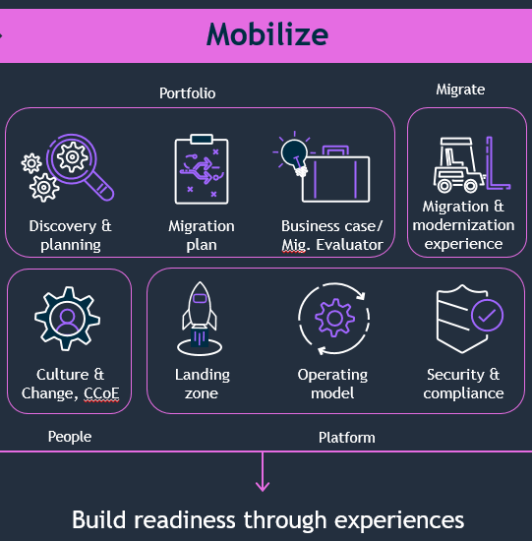
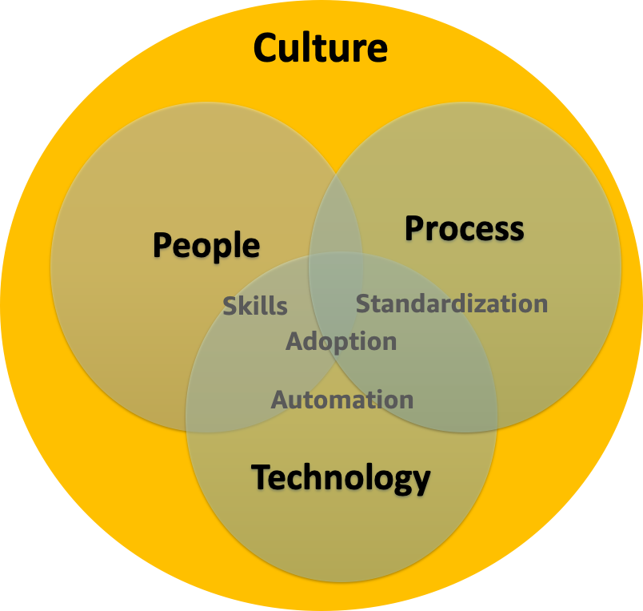
Mobilize Outcomes
Mobilize
Fully evaluated digital landscape, based on criteria tailored to customer’s priorities, to determine good candidates for cloud
Repeatable playbooks (and runbooks) for Governance, Architecture, Security, Operations, and Migration to enable production at scale while limiting complexity
A critical mass of personnel with hands-on experience using AWS and training plans to enable acceleration of business outcomes and operational efficiency
Capture best-practices for Change Acceleration for rapid deployment and sustainable change ownership relating to Culture, Leadership Alignment, Organizational Readiness, Workforce Transformation, and realized Business Value

Slide 42
P&C FRAMEWORK & OUTCOMES
ENGAGEMENT AND READINESS
LEADERSHIP ALIGNMENT
ORG MODEL & ROLES
CONTINUOUS IMPROVEMENT
CHANGE COMPONENTS
OUTCOMES
COMMUNICATIONS
BUSINESS ADOPTION
TRAINING AND KNOWLEDGE TRANSFER
RETURN ON INVESTMENT
Notes:
Our 6-point framework is at the heart of our approach. That’s the framework.
We have an evidence-based process of Align, Engage, Sustain that is repeatable and usable in sprints, as companies strive to stay in a ready state of change.
Our differentiator is that we prioritize helping our clients achieve their most important business outcomes through our adaptable and customizable application of change management methods and our ability to pivot as needed while deploying our process.
Bottom line is, our pragmatic approach gets results: ROI-designed to accelerate adoption , minimize degree of performance dip and shorten project completion time
We recognize the importance of effective Change Acceleration to the success of any transformational improvement initiative. Our recommendations are underpinned with programmatic change management elements to guide organizational and individual transitions. Our approach encompasses four core change components and designed to drive adoption and desired outcomes for enterprise ownership and Business as Usual change readiness culture.
Mobilize Team
Align Leaders
Envision the Future
Engage the Organization
Enable Capacity
Make It Stick
Reduced compliance risk exposure • Improved CSAT • Increased production service delivery • Lower support costs and improved margins • Increased speed to market for product/services • Increased business growth

Slide 43

Engagement Migration Team Structure and Roles
Mobilize
AWS Role | Responsibilities |  | Customer Role
Practice Manager, Program Manager | Engagement delivery, quality and execution. Customer relationship |  | Executive Sponsorship (IT & Business)
Engagement Manager | Day to day engagement management that includes the management of: delivery, budget, schedule, status, resources, and customer relationship. |  | Program/Project Manager
Portfolio Lead, Cloud Application Architect | Portfolio Discovery and Modernization Planning |  | Application Engineering, DevOps Lead, Infrastructure Engineering, Information Security, Networking, PCAT, (IT POCs)
Tech Lead & Landing Zone, Operations Lead, Security Lead | Platform Validation and Governance (architecture, operations, security) and lead Platform Party, Operations & Security Game Day activities |  | Infrastructure Engineering, Information Security, Networking, PCAT, (IT POCs)
People Lead | Culture and change leadership framework to accelerate Cloud adoption by proactively managing culture, organization, and talent |  | OCM Lead Executive Sponsor
IT Points of Contact (POC)

Slide 44
Determine the right migration pattern for your apps
Mobilize
Disconnected and incomplete data
Discover and organize data
7 Rs
Refactor
Re-platform
Asset inventories
Performance information
App configuration data
Level of effort
Repurchase
Applications
Rehost
Relocate
Migration plan
(Backlog)
CMDB
SLA/OLA
Architecture
Performance
Retain
Infrastructure
Retire
Tribal knowledge
Notes:
Understanding the details of the current environment including where the data is, not just application data but operational data, how it is used and accessed is critical
AWS and our partners offer a collection of tools to help you make better decisions for architecture, modernization, and migration planning by discovering the current environment, dependencies, and identifying where there may be gaps in knowledge that need to be addressed to plan the migration
AWS with partners help evaluate the 7Rs of migration and classify workloads for Rehost, Replatform, Refactor, Relocate, Repurchase, Retire, and Retain
In the planning stage we help customers move the first few applications into production while we plan to deliver the migration at scale
Amazon Athena - Athena helps you analyze unstructured, semi-structured, and structured data stored in Amazon S3. Examples include CSV, JSON, or columnar data formats such as Apache Parquet and Apache ORC. You can use Athena to run ad-hoc queries using ANSI SQL, without the need to aggregate or load the data into Athena.
------------------------------------------

Slide 45
VMware Cloud on AWS Overcome migration obstacles when moving VMware environments to AWS Cloud
Migrate & modernize
vRealize Suite, third-party vSphere ecosystem
VMware SDDC running on AWS bare metal
Delivered, operated, and supported by VMware
On-demand capacity and flexible consumption
Full operational consistency with on-prem SDDC
Support for vSphere qualified solutions
Global AWS footprint, availability, and scale
Direct access to native AWS services
VMware SDDC
on-premises
VMware CloudTM on AWS Powered by VMware Cloud Foundation
AWS services
vCenter
vCenter
vSphere
vSAN
NSX
Large-scale application migration
Customer Data Center
AWS Global Infrastructure
No application re-factoring or re-architecting needed
Familiar and proven VMware environment combined with the global AWS footprint, reach and scale
No retraining of staff or revamping of operational processes
Bi-directional live application migration to avoid disruption in business transactions, scale capacity in a few minutes
Click here to learn more
Notes:
VMware Cloud on AWS together with VMware Hybrid Cloud Extension enables customers to accelerate their cloud migration in the simplest, fastest and lowest risk way with compelling TCO.
VMware CloudTM on AWS brings VMware’s enterprise class Software-Defined Data Center software to the AWS Cloud, and enables customers to run production applications across VMware vSphere®-based private, public and hybrid cloud environments, with optimized access to AWS services.
Delivered, sold and supported by VMware and its partners as an on-demand service, VMware Cloud on AWS enables IT teams to manage their cloud-based resources with familiar VMware tools – without the hassles of learning new skills or utilizing new tools.
VMware Cloud on AWS integrates VMware’s flagship compute, storage and network virtualization products (VMware vSphere®, VMware vSANTM and VMware NSX®) along with VMware vCenter® management and robust disaster protection, and optimizes it to run on dedicated, elastic, Amazon EC2 bare-metal infrastructure that is fully integrated as part of the AWS Cloud.
With the same architecture and operational experience on-premises and in the cloud, IT teams can now quickly derive instant business value from use of the AWS and VMware hybrid cloud experience.
VMware Hybrid Cloud Extension (HCX) provides application migration and infrastructure hybridity without application downtime or infrastructure retrofit.
The VMware HCX service offers bi-directional application landscape mobility and datacenter extension capabilities between any vSphere version.
HCX includes patent-pending capabilities to support VMware vSphere® vMotion®, Bulk Migration, High Throughput Network Extension, WAN optimization, traffic engineering, automated VPN with Strong Encryption (Suite B) and secured datacenter interconnectivity with built-in vSphere protocol proxies.
VMware HCX enables cloud on-boarding without retrofitting source infrastructure supporting migration from vSphere 5.0+ to VMware Cloud on AWS without introducing application risk and complex migration assessments.
------------------------------------------

Slide 46
Simplify and accelerate migration with CloudEndure Migration
Migrate & modernize
Fast
Flexible
Non-disruptive
Secure
Simple setup lets you start in minutes
Wide range of OS, application, and database support
Robust, predictable, nondisruptive continuous replication and minimal cutover windows
Highly secure for regulated environments
CloudEndure Migration is free to all AWS customers
Click here to learn more
Notes:
AWS and our partner ecosystem offer the most mature and complete set of tools to help automate and simplify migration of most any workload.
CloudEndure, acquired by AWS in January 2019, is used by customers and APN partners for large scale lift-and-shift server migrations.
CloudEndure supports a wide variety of source platforms, i.e., physical, virtual
CloudEndure uses a unique block-level replication strategy to achieve a near zero down-time migration
Customers using CloudEndure have successfully migrated thousands of servers, over a weekend with very tight service windows
CloudEndure is available to use at no cost to all customers
Designed for rapid, mass-scale migrations of servers and databases
Simple setup lets you start in minutes
Same highly automated process for any workload (regardless of OS type/version, application, or DBs)
Migrate with minimal business disruption
Eliminates complexity and reduces risk
And it’s now available for free to all AWS customers!
Link: https://aws.amazon.com/cloudendure-migration/
------------------------------------------

Slide 47
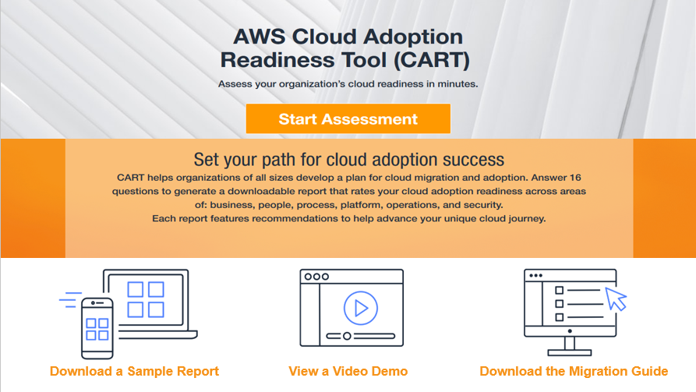
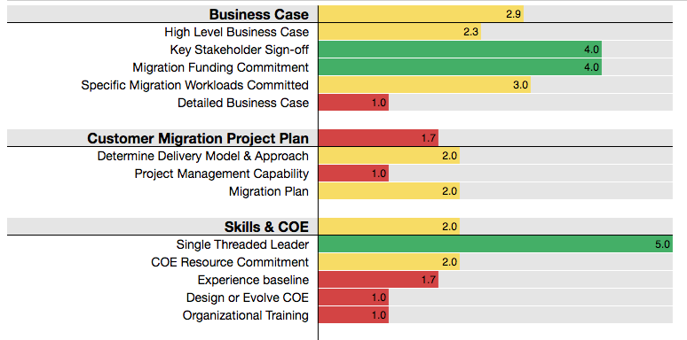
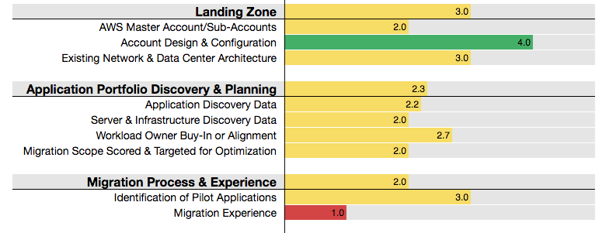
Tools to help assess readiness and build a business case
Assess
Cloud Adoption Readiness Tool
Migration Readiness Assessment Workshop
Migration Evaluator
Online self-service tool
16 questions across 6 perspectives
Custom report (URL or PDF)
High-level recommendations on what is required to adopt cloud successfully
Suitable for early stage discussions and small-scale migrations
1-day workshop
~70 questions to identify readiness and gaps for a large-scale migration
Action plan proposal to close the gaps
Leverages existing inventory or
agent-less discovery tool
Highlights the financial impact of different software licensing strategies
Completed business case and TCO analysis
Optimize compute, storage and database
Assess your readiness
Build directional business case
Notes:
Links:
CART - https://cart.splashthat.com/
MRA Workshop (MAP progra,) - https://aws.amazon.com/migration-acceleration-program/
Migration Evaluator – https://aws.amazon.com/migration-evaluator

